Slide 1
System Security
Maricia Epps

Slide 2
Introduction
The purpose of this project is to use technical, and administrative controls, as well as encryption to secure file management and mitigate risks to enterprise data assets. I will also demonstrate how firewalls are use to protect enterprise computing resources from attacks, create a bring your own device (BYOD) policy, implement multifactor authentication (MFA), and conduct a vulnerability assessment.

Slide 3
Asymmetric Key Encryption

Slide 4
I addressed security vulnerabilities by disabling unnecessary services, implemented a stateful firewall to allow access from approved hosts, implemented security controls to protect against dictionary and brute force attacks, and implemented asymmetric key encryption using GPG.
This Photo by Unknown Author is licensed under CC BY-SA

Slide 5
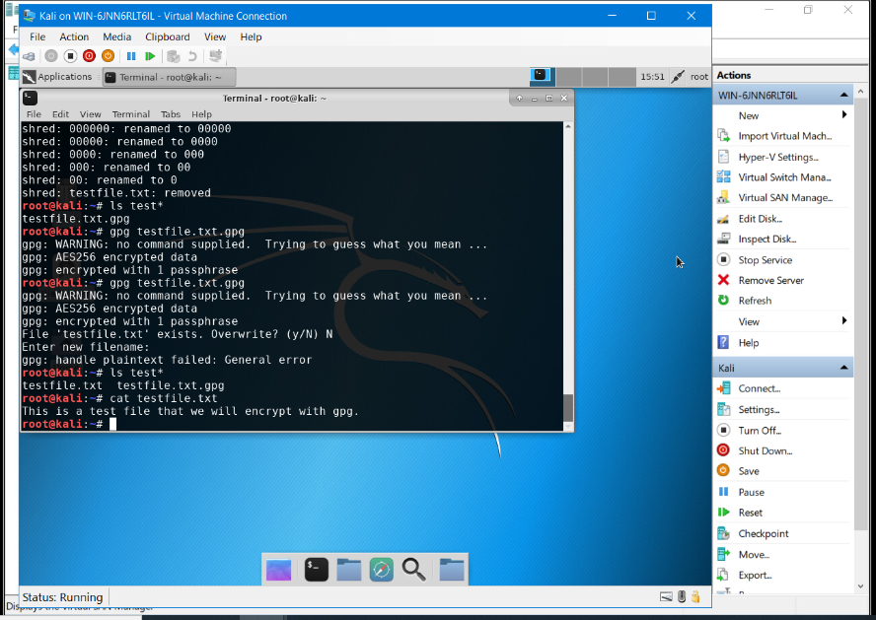
File Encryption
Content of the plaintext file
Content of the encrypted file

Slide 6
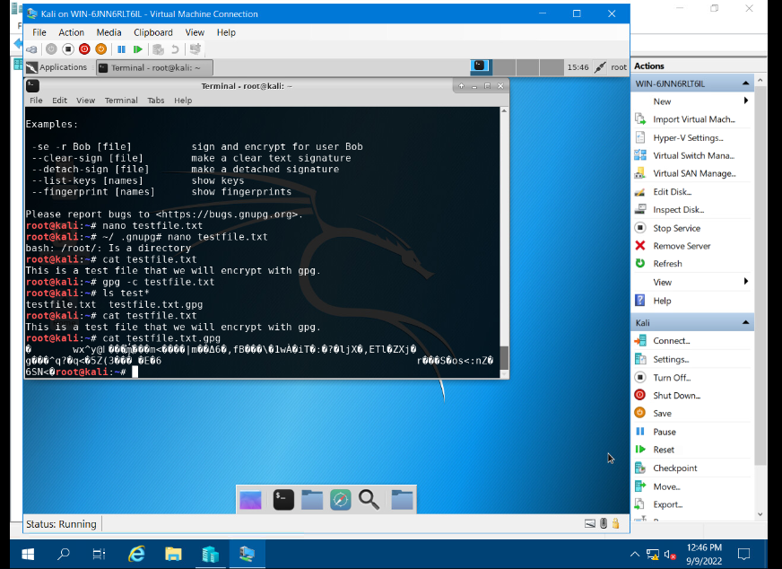
File Decryption
The encrypted file being listed by itself
The decrypting process
Both the encrypted file and the original plaintext file being listed

Slide 7
Stateful firewall

Slide 8
I addressed security vulnerabilities by enhancing user management, implementing a stateful firewall to allow access from approved hosts only, encrypted data at rest and in transit, and hardened the Linux server by setting up a stateful firewall with iptables.
This Photo by Unknown Author is licensed under CC BY-NC-ND

Slide 9
Question
What effect does the sudo iptables --policy INPUT DROP command have on the access to computing resources?
Answer here: It closes all open ports.

Slide 10
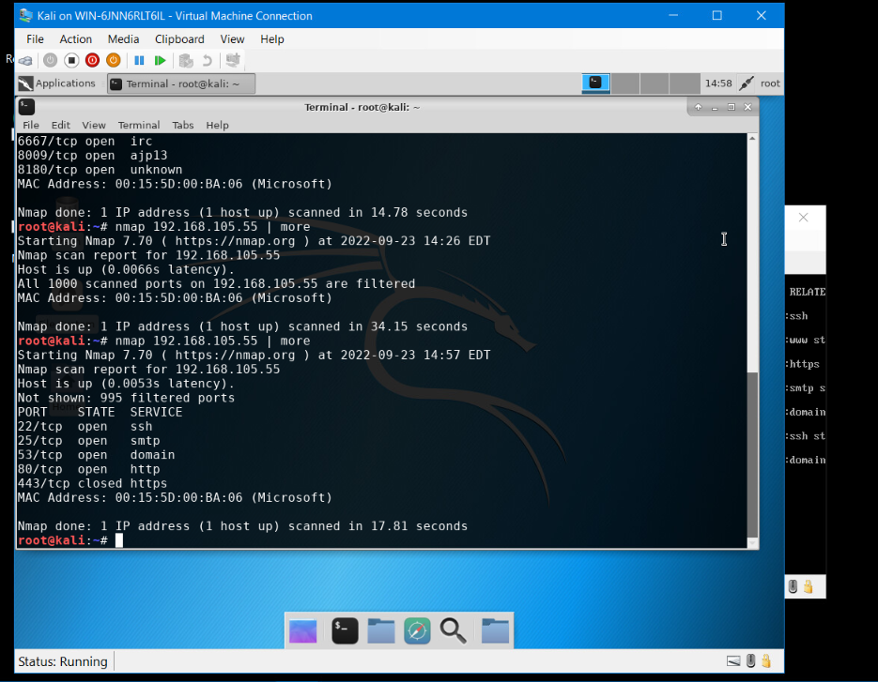
Nmap Scan
The Nmap scan result of the Linux Server VM.

Slide 11
Bring your own device (byod) Security policy

Slide 12
I created a bring your own device (BYOD) policy. This policy is used to clarify expectations regarding the use of computing resources more specifically employees using their own devices.
This Photo by Unknown Author is licensed under CC BY-NC-ND

Slide 13
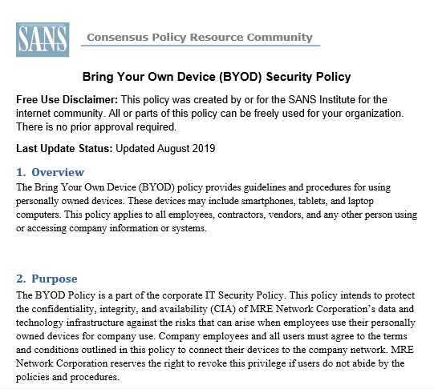
BYOD Security Policy.docx

Slide 14
Multifactor authentication (mfa)

Slide 15
I addressed security vulnerabilities by implementing multifactor authentication (MFA) by adding a time-based one-time password (OTP) to the authentication process
This Photo by Unknown Author is licensed under CC BY-NC

Slide 16
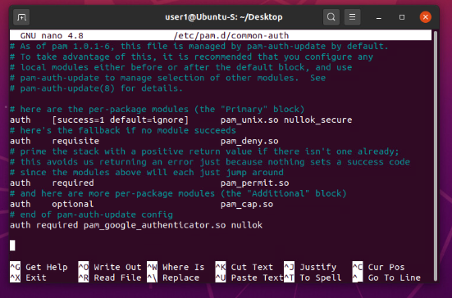
Common-auth Configuration File
The entry that indicates the use of the Google Authenticator module.

Slide 17
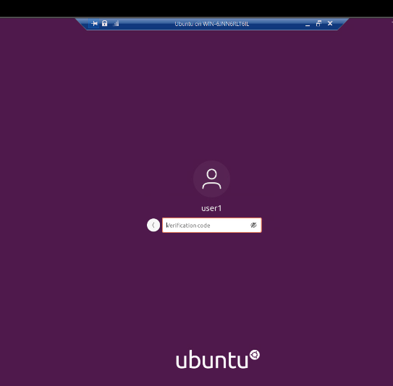
MFA Logon Screen
The logon screen where a verification code is required.

Slide 18
Vulnerability assessment

Slide 19
I conducted a vulnerability assessment of a server using NMAP (the network mapper), Netcat, and Wireshark.
This Photo by Unknown Author is licensed under CC BY-ND

Slide 20
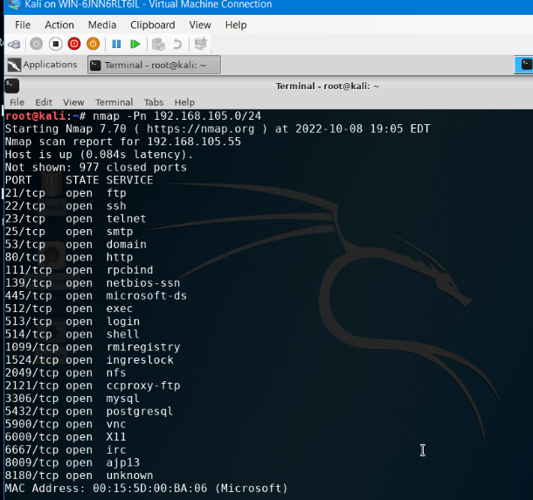
Nmap
The scan result showing both the Kali and Linux Server VMs.

Slide 21
NetCat
This screenshot should include the scan result showing both the Kali and Linux Server VMs.

Slide 22
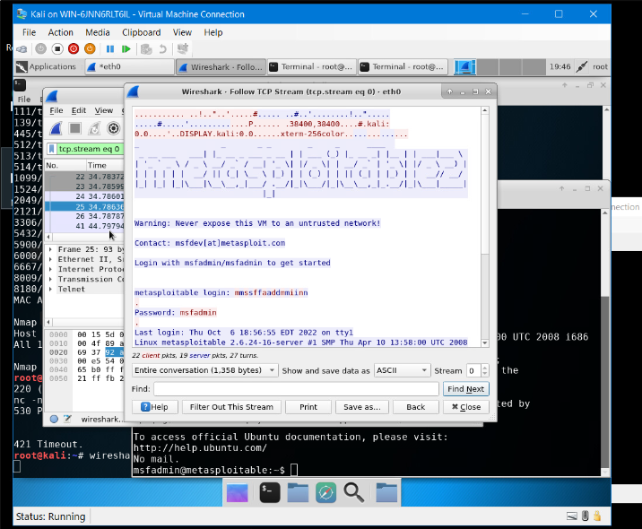
Wireshark
The Wireshark—Follow TCP Steam window showing the Telnet username and password.

Slide 23
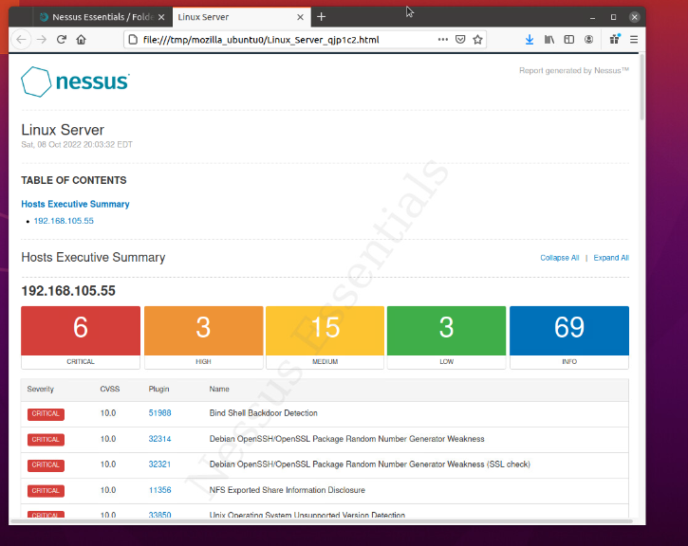
Nessus
The high-level view of the Nessus vulnerability scan report (showing categories of vulnerability in different colors).

Slide 24
Challenges
The biggest challenge I faced was when executing the commands for NetCat my @root would not reappear on the next line after the command had been executed. I believe it was a glitch inside of the testing environment due to it only happening when inputting those specific commands.

Slide 25
Career Skills
Prevent and mitigate network attacks
Vulnerability testing
Firewalls
Encryption solutions

Slide 26
Summary
I used technical, and administrative controls, as well as encryption to secure file management and mitigate risks to enterprise data assets. I also demonstrated how firewalls are used to protect enterprise computing resources from attacks, created a bring your own device (BYOD) policy, implemented multifactor authentication (MFA), and conducted a vulnerability assessment.
This Photo by Unknown Author is licensed under CC BY-SA
This Photo by Unknown Author is licensed under CC BY-SA
This Photo by Unknown Author is licensed under CC BY-SA

Slide 27
Thank you
Maricia Epps
maricia.epps@gmail.com
https://mariciaepps.wixsite.com/website

