Slide 1

Building a Network
By: Maricia Epps

Slide 2
Introduction
This project covers the fundamentals of networking in the world of IoT. The design and development process of building the network includes the SOHO router configurations, subnetting, connectivity testing, network documentation and SOHO wireless network security.

Slide 3
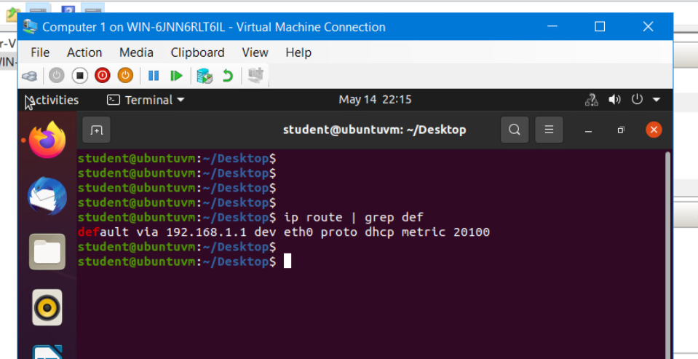
Preparation
The terminal window that shows the default gateway IP address.

Slide 4
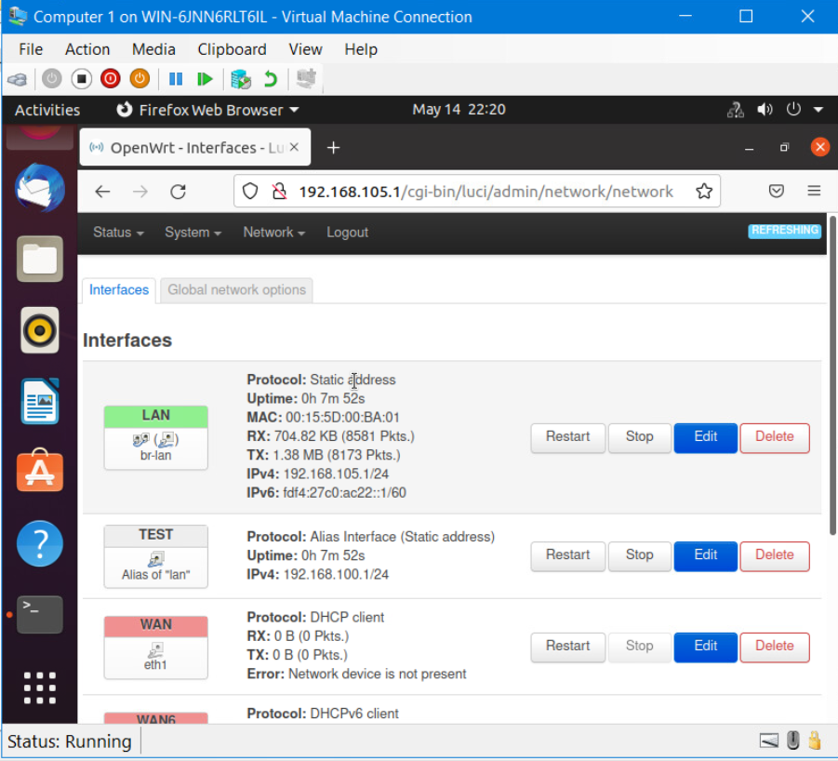
IPv4 Address Assignment
The Interfaces page that shows the new IPv4 address on the LAN interface.

Slide 5
Connectivity Testing

Slide 6
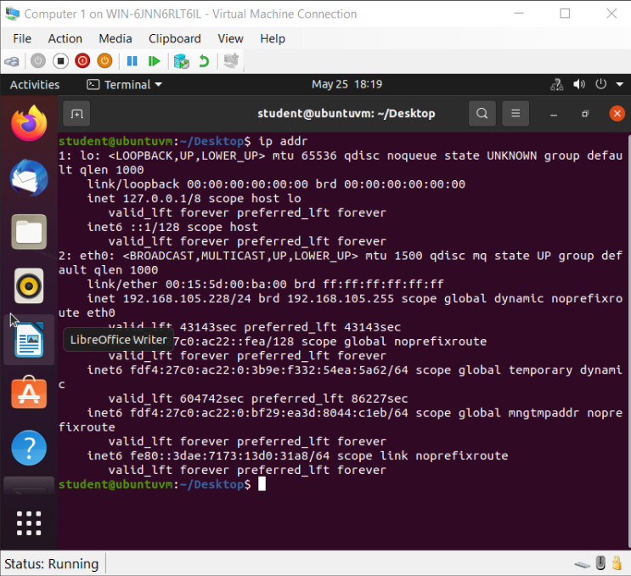
Dynamic IP Address Assignment
The IPv4 address of the Computer 1 VM.

Slide 7
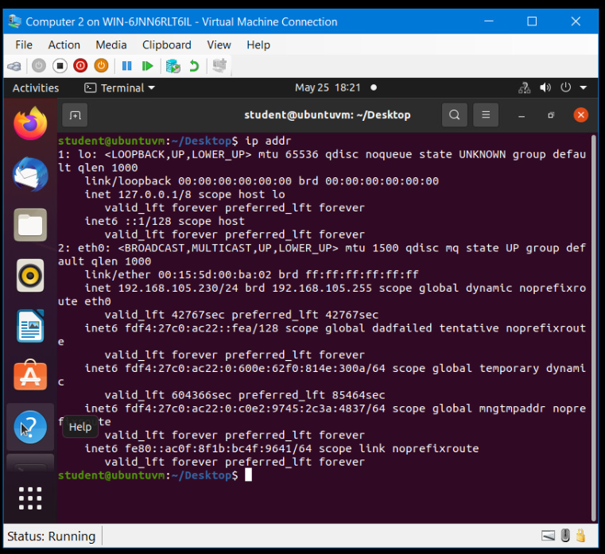
Dynamic IP Address Assignment
The IPv4 address of the Computer 2 VM.

Slide 8
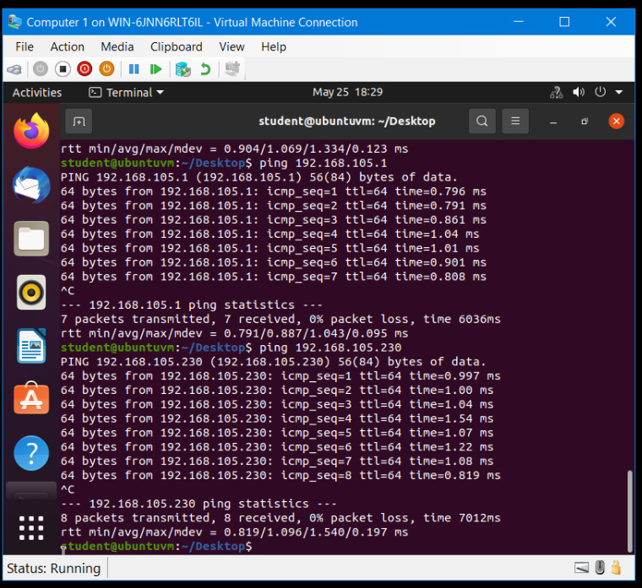
Connectivity Test
The connectivity tests between the Computer 1 VM and the other two devices (i.e., the SOHO Router VM and Computer 2 VM).

Slide 9
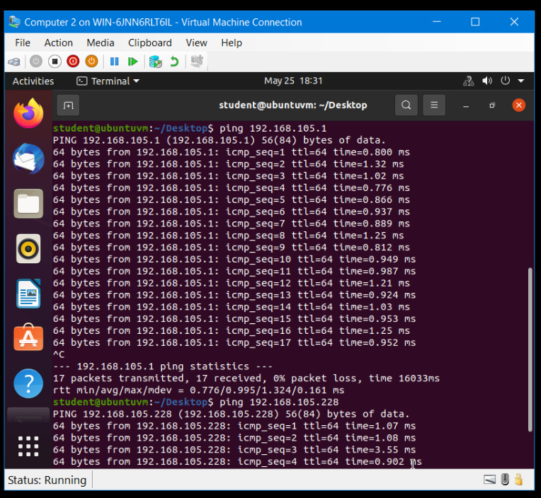
Connectivity Test
The connectivity tests between the Computer 2 VM and the other two devices (i.e., the SOHO Router VM and Computer 1 VM).

Slide 10
IP Subnetting and Loopback Interfaces

Slide 11
Subnetting Table
This table includes two /25 subnets, listing the subnet notation, network address, first usable host address, last usable host address, and broadcast address of each subnet.
Subnet | Subnet Notation | Network Address | First Usable Host Address | Last Useable Host Address | Broadcast Address
The First Subnet | 192.168.5.0/25 | 192.168.5.0 | 192.168.5.1/25 | 192.168.5.126 | 192.168.5.127
The Second Subnet | 192.168.5.128/25 | 192.168.5.128 | 192.168.5.129 | 192.168.5.254 | 192.168.5.255

Slide 12
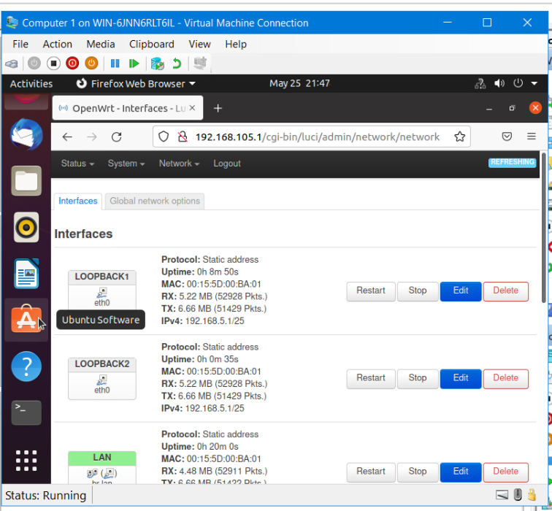
Loopback Interfaces
Loopback1 and Loopback2 interfaces and their correct IPv4 addresses.

Slide 13
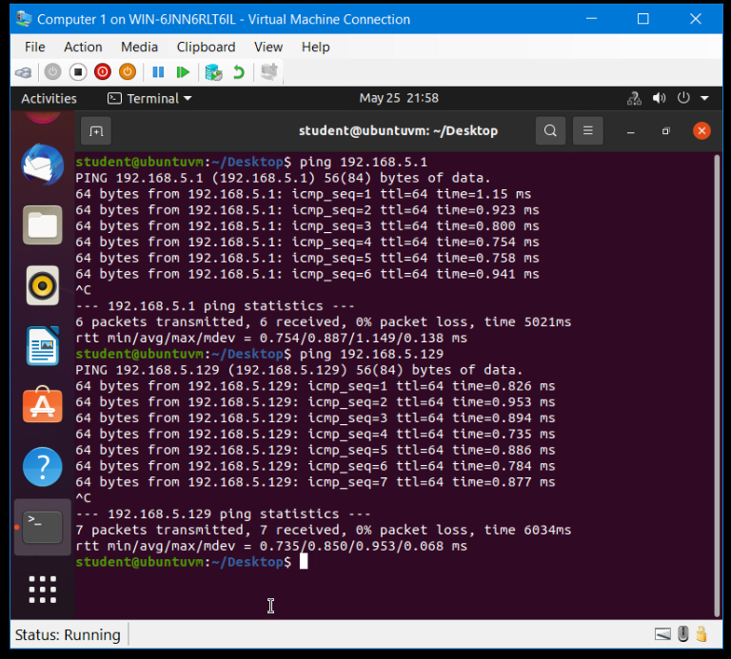
Connectivity Tests
Two successful ping tests from the Computer 1 VM to the Loopback 1 and Loopback 2 interfaces.

Slide 14
Visio Network Diagram

Slide 15
Microsoft Visio Network Diagram
This diagram illustrates the interconnection of the Computer 1 VM, the Computer 2 VM, and the SOHO Router VM.

Slide 16
SOHO Wireless Network Security

Slide 17
SOHO Wireless Network Security
What are the factory default username and password of a TP-Link router? Why is it important to change the default username and password of a SOHO router?
Answer: The default username and password of the TP-Link router is admin. It is important to change the default username and password to ensure the security of the router.
To protect a SOHO wireless network with a small number of devices, which address management method provides more control, configuring the device IP addresses manually (static IP) or using a DHCP server (dynamic IP)? Why?
Answer: Configuring the device IP address manually will provide more control since the static IP does not change.
What does MAC filtering do? If needed, when would you use deny filtering rules and when would you use allow filtering rules? What happens to devices that want to connect, if the “Allow the stations specified by any enabled entries in the list to access” function is enabled but there are no entries in the list?
Answer: MAC filtering allows you to block traffic coming from certain machines or devices. I would deny filtering rules if only one device is on the network. I would allow filtering rules if I needed to allow more than one device access to the network. The device will now be allowed to connect.

Slide 18
SOHO Wireless Network Security
What wireless security settings are displayed on the Wireless Security page? Which one is recommended by the vendor? Why?
Answer: Disable Wireless Security, WPA/WPA2 – Personal, WPA/WPA2 – Enterprise, and WEP. WPA/WPA2 – Personal is the recommended option by the vendor.
Among the configurations you explored in this module, which one is a true security function? Why?
Answer: Wireless security is a true security function. It allows you to create a unique password.
What would you do to protect your wireless network at home? Why?
Answer: I would use a secure passcode that only my family knows. I would create a guest access point that friends and family can use when visiting and I would change these passwords periodically to ensure the protection of my home network.

Slide 19
Challenges
The challenge I faced completing this project was with the calculations in completing the subnetting chart.

Slide 20
Career Skills
The career skills I developed in completing this course project are:
Analytical skills
Problem-solving skills
Communication
Networking skills
Persistence

Slide 21
Conclusion
This was a very fun project to work on and I learned a lot throughout the course of completing this project. I was met with challenges that I had to overcome and still conquering. I was tested in ways that frustrated me, but ultimately making me a better networker and programmer.

