Slide 1
Network Production using a cloud platform
By
Maricia Epps

Slide 2
Introduction
The purpose of this project was to get a better understanding of cloud computing by examining network services on a cloud platform, identifying cloud centric access control techniques, assessing cloud-centric security language, evaluating cloud storage techniques, use common maintenance tools and services, and produce a network on a cloud platform.

Slide 3
Virtual Machine (VM) Instances

Slide 4
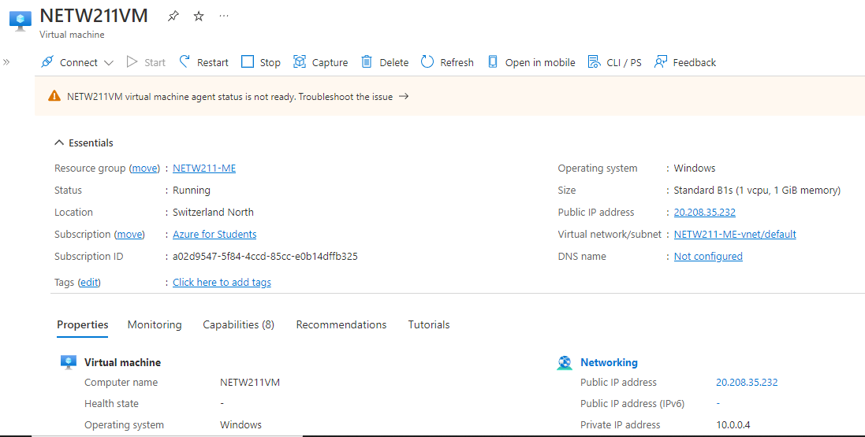
Deploying a VM in Azure
This screenshot shows the NETW211VM page with information such as the resource group name, subscription, public IP address, etc.

Slide 5
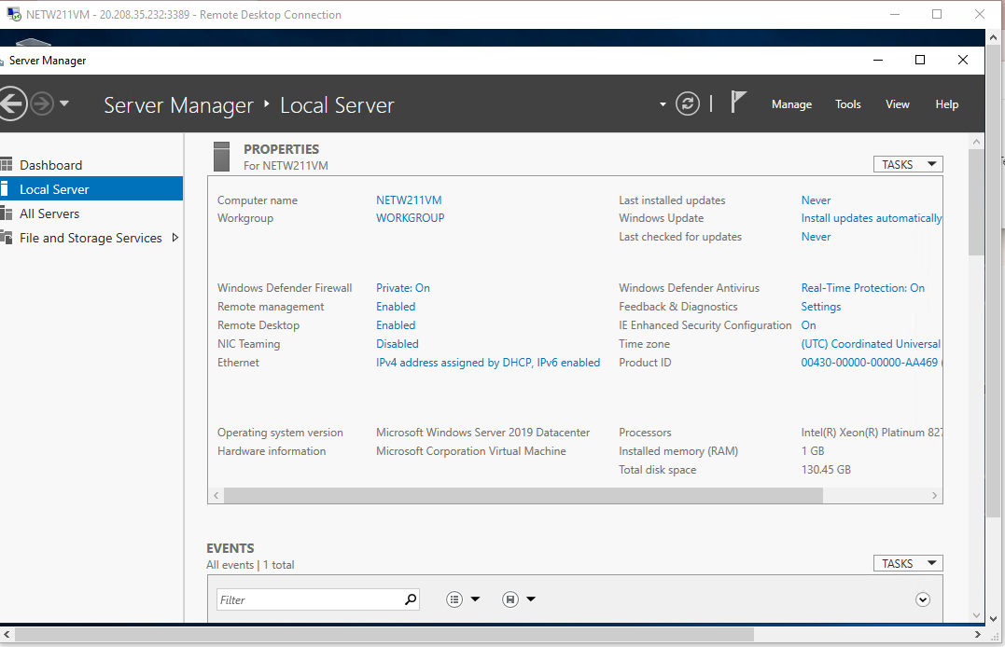
Connecting to the VM
This screenshot shows the PROPERTIES for NETW211VM page, with the computer name, operating system version, hardware information, etc.

Slide 6
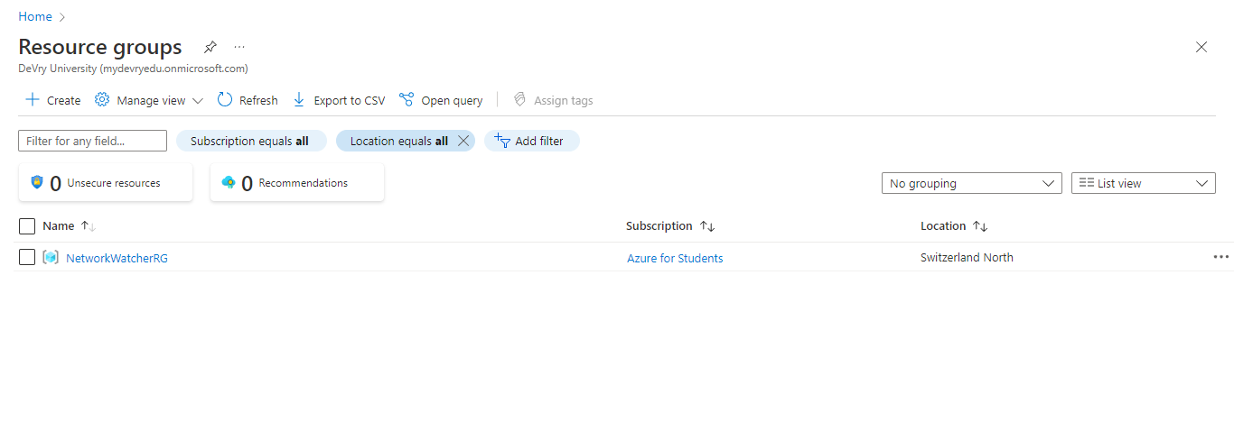
Deleting
the VM
This screenshot shows the Resource groups page, with the Azure for Students subscription selection and the “No resource groups to display” message.

Slide 7
Azure vnet and subnets

Slide 8
Creating a VNet with Two Subnets
1. With a /24 network prefix, how many usable IPv4 host addresses are there?
a.) 254
2. Given the answer above, why is the number of available IP addresses for Subnet0 (10.0.0.0/24) or Subnet1 (10.0.1.0/24) shown as 251?
a.) Because Azure has the first four and last IP addresses reserved.

Slide 9
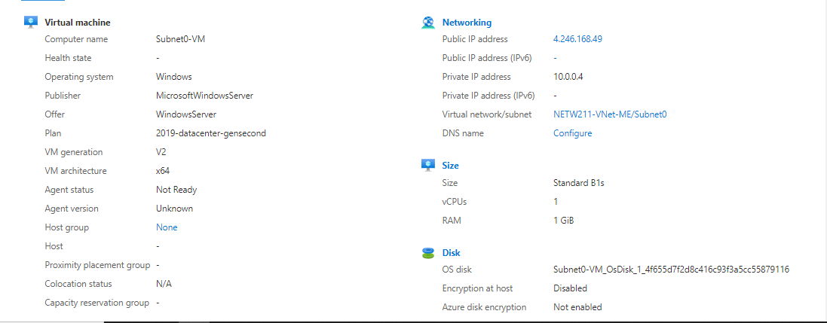
Deploying VMs into Subnets
This screenshot shows the Properties section of the Subnet0-VM page, showing the networking and size information of the VM.

Slide 10
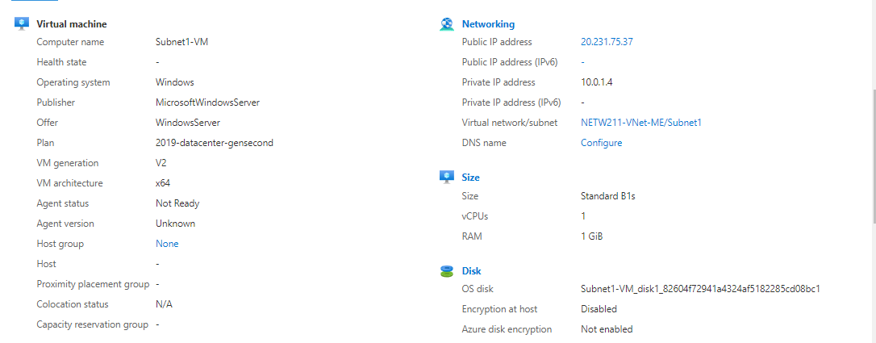
Deploying VMs into Subnets cont’d
This screenshot shows the Properties section of the Subnet1-VM page, showing the networking and size information of the VM.

Slide 11
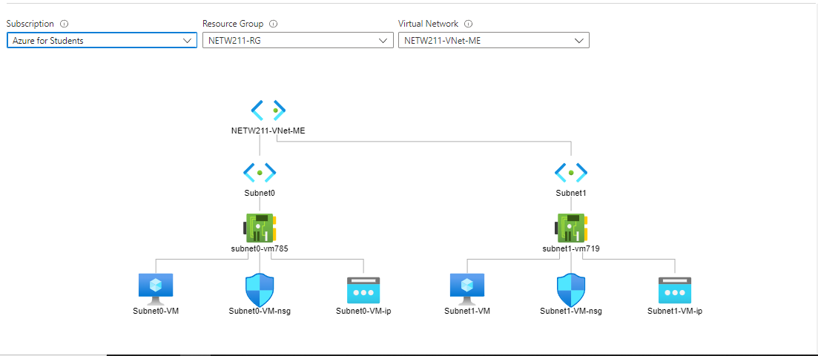
Deploying VMs into Subnets cont’d
This screenshot shows the topology diagram of your VNet (NETW211-VNet-ME) with two subnets (Subnet0 and Subnet1) and one VM in each subnet (Subnet0-VM and Subnet1-VM).

Slide 12
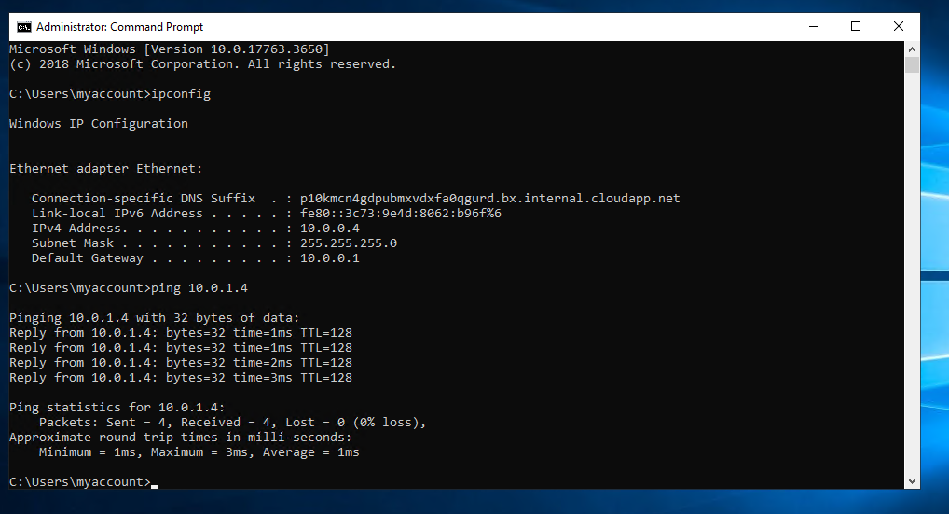
Verifying Connectivity between VMs
This screenshot shows the ipconfig and ping 10.0.1.4 results in the command prompt window, including the Subnet0-VM – 10.0.0.4– Remote Desktop Connection window title.

Slide 13
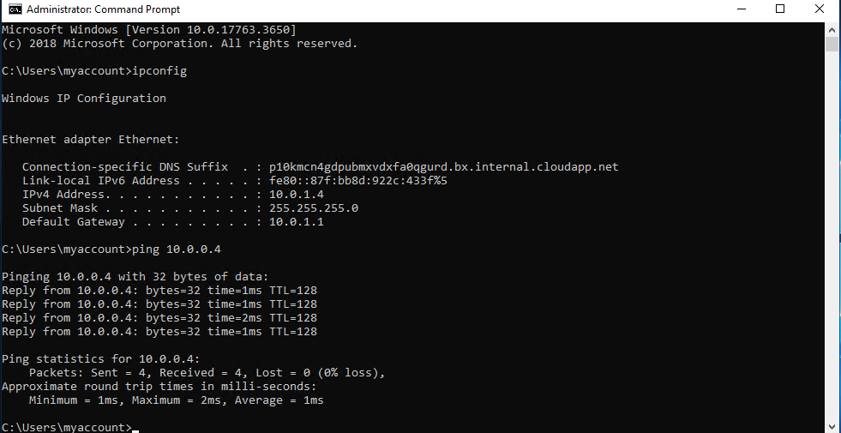
Verifying Connectivity between VMs
cont’d
This screenshot should show the ipconfig and ping 10.0.0.4 results in the command prompt window, including the Subnet1-VM – 10.0.1.4– Remote Desktop Connection window title.

Slide 14
Azure vm security

Slide 15
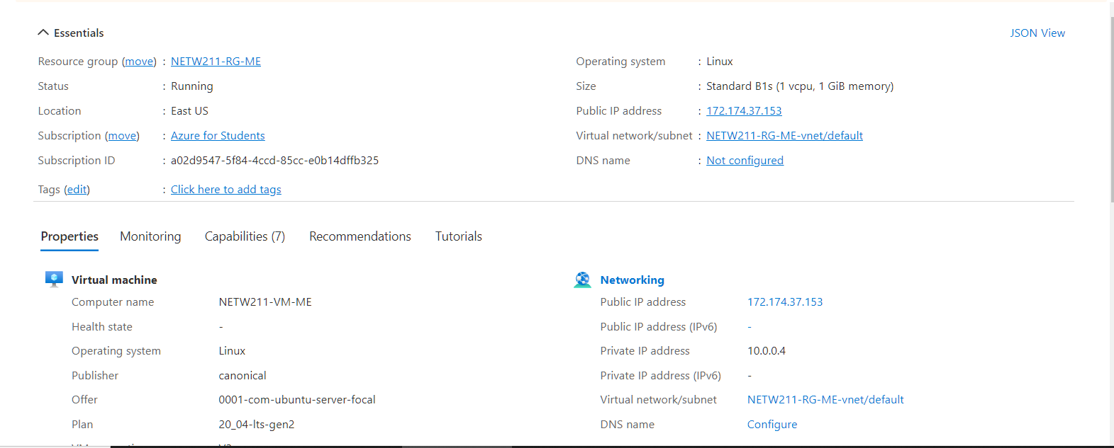
Launching a VM
This screenshot shows the NETW211-VM-ME page, with information such as the resource group name, subscription, public IP address, etc.

Slide 16
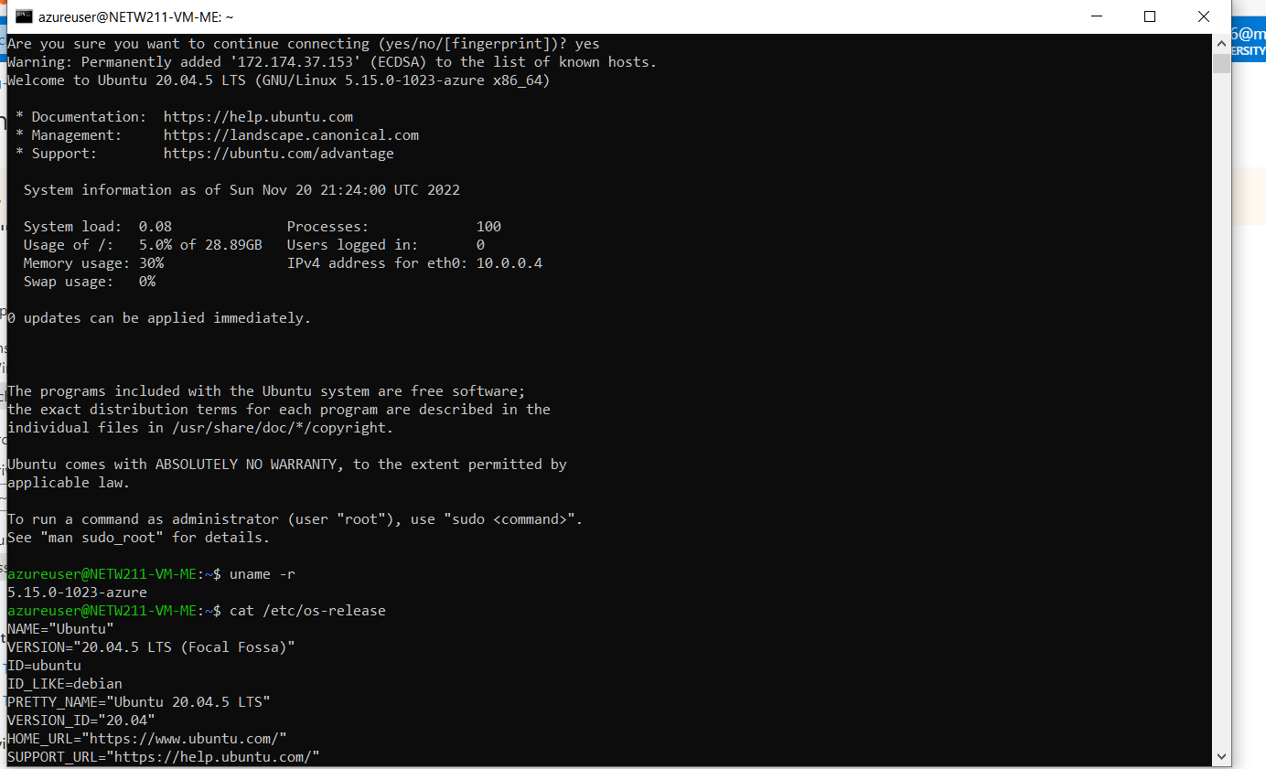
Connecting to the VM
via SSH
This screenshot shows the azureuser@NETW211-VM-ME window showing the IPv4 address of the VM in the Azure cloud.

Slide 17
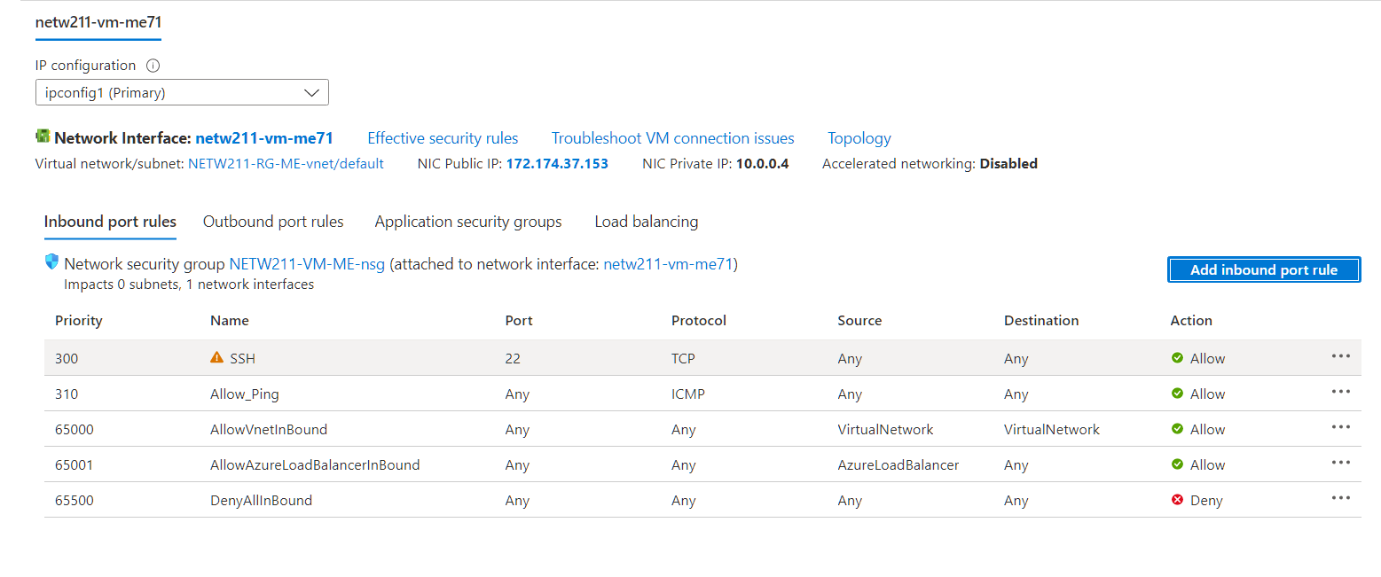
Configuring an NSG
This screenshot shows the Inbound port rules section with the newly added Allow_Ping rule.

Slide 18
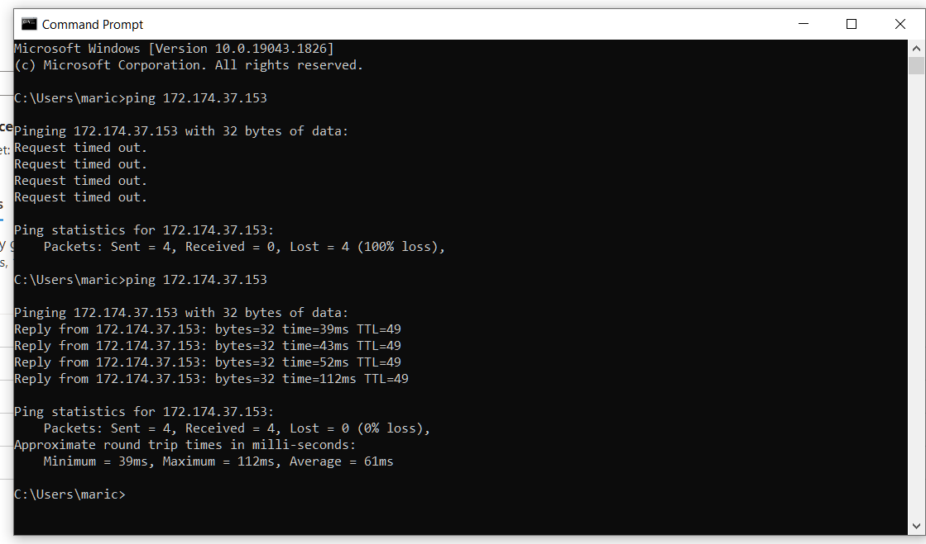
Configuring an NSG
cont’d
This screenshot shows the successful ping result from your local computer to the VM in the Azure cloud.

Slide 19
Cloud storage

Slide 20
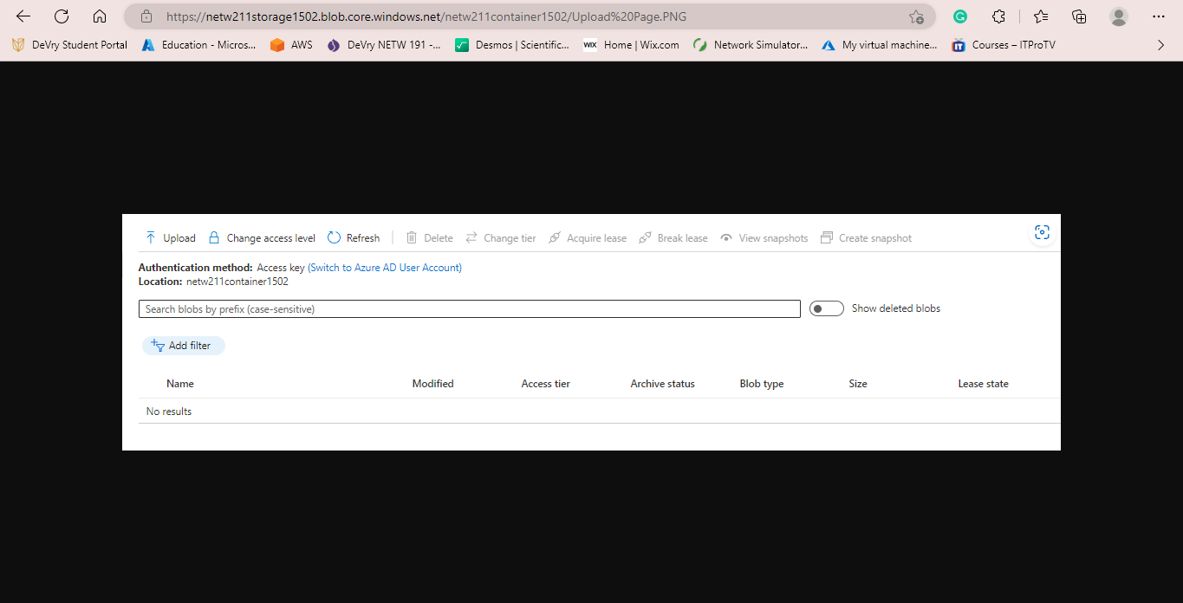
Uploading and Accessing a File
This screenshot shows the browser window with the image uploaded from your local computer and the URL on top of the window.

Slide 21
Question
What does the access tier setting do? What are the Azure blob storage access tiers?
a.) It determines in which online tier a new blob is created by default.
b.) Hot Access tier, Cool Access tier, and Archive tier. They target data at different stages of its lifecycle and offer cost effective storage options.

Slide 22
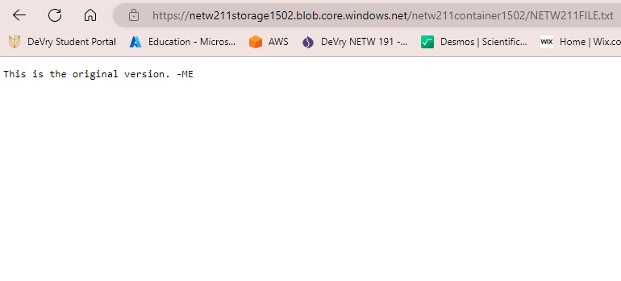
Creating Blob Snapshots
This screenshot shows the browser window with the “This is the original version. –ME” message and the URL on top of the window

Slide 23
Enabling Blob Versioning
This screenshot shows the browser window with the “This is the first revised version. –ME” message and the URL on top of the window.

Slide 24
Cloud monitoring

Slide 25
Setting up an Action Group and Notifications
This screenshot shows the “VM-Status-Change” action group on the Manage actions page.

Slide 26
Setting up Alert Rules
This screenshot shows the Alert rules window showing the VM-Deallocate and VM-Restart rules.

Slide 27
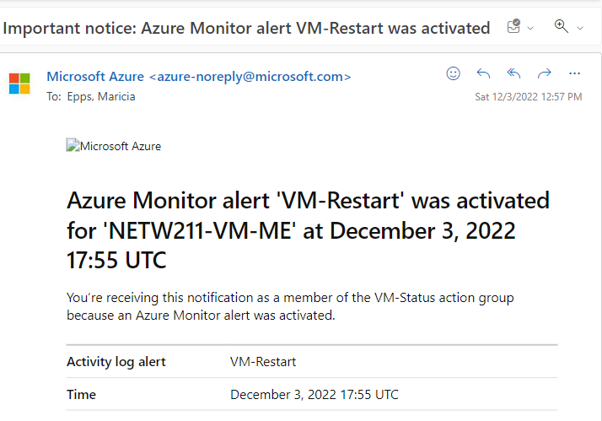
Testing Alerts
This screenshot shows the ‘VM-Restart’ was activated email message with the date and time of the alert.

Slide 28
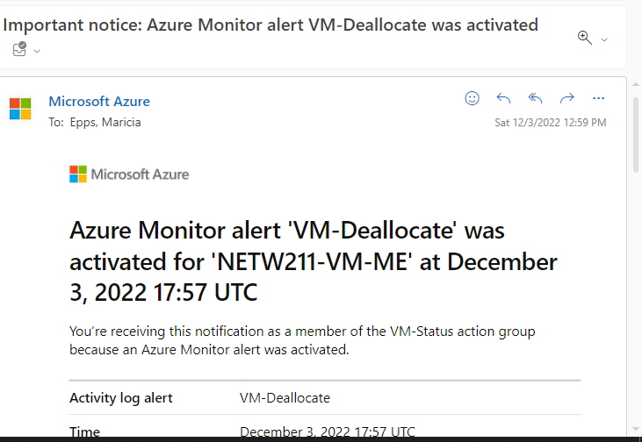
Testing Alerts cont’d
This screenshot shows the ‘VM-Deallocate’ was activated email message with the date and time of the alert.

Slide 29
Challenges
This project was fun and interesting to complete. I didn’t find any challenges with completing this project. My biggest challenge would have been determining why the Azure IP address /24 prefix was showing 251 when it should have shown 254. I was able to successfully determine the reason why by further reviewing my references.

Slide 30
Career Skills
Deploying, connecting, and deleting a VM in Azure
Creating a VNet with two subnets and deploying VMs into Subnets
Verifying connectivity between VMs
Connecting to a VM via SSH
Configuring an NSG
Creating a Storage Account and Container
Uploading and Accessing a File
Creating Blob Snapshots
Setting up an Action group and notifications
Setting up Alert rules
Testing Alerts

Slide 31
conclusion
In completing this project, I now have a better understanding of the Azure VM service that provides secure and resizable compute capacity in the cloud. The Azure VNet service as it allows customers to provision a logically isolated section of the Azure cloud and launch resources into a virtual network. How to securely connect to an Azure VM via SSH, and how to control inbound and outbound traffic by configuring an NSG, and how to monitor Azure resources using the Azure Monitor service.

Slide 32
references
Create Your Azure Free Account Today | Microsoft Azure
IP Subnet Calculator, https://www.calculator.net/ip-subnet-calculator.html
Azure Virtual Network frequently asked questions, https://docs.microsoft.com/en-us/azure/virtual-network/virtual-networks-faq
Hot, Cool, and Archive access tiers for blob data, https://docs.microsoft.com/en-us/azure/storage/blobs/access-tiers-overview
Azure Blob Storage Access Tiers, https://devry.percipio.com/courses/c7ef0333-8560-403f-a004-9c5c843866b0/videos/2658bbe6-ee97-438b-a376-fbb079c3b3a0

Slide 33
THANK YOU
Maricia Epps
maricia.epps@gmail.com
https://mariciaepps.wixsite.com/website

