Slide 1

Weather Data Analysis System
By: Maricia Epps

Slide 2

This project aimed to develop a software system to download weather data from a cloud source, store it, and extract it using programming and data analytics to analyze data and develop charts and predictions.
Introduction

Slide 3
Design and library setup
Develop a systematic process for the weather data analysis system, develop a flowchart for the IPO, and download the weather observations from NOAA using Python.

Slide 4
Flowchart
Include the following processes:
Install python
Download weather data to a database.
Extract weather data from database into a comma separated file with python
Cleanse weather data
Use Excel to manipulate data
Use python data analytics modules to develop graphical models

Slide 5
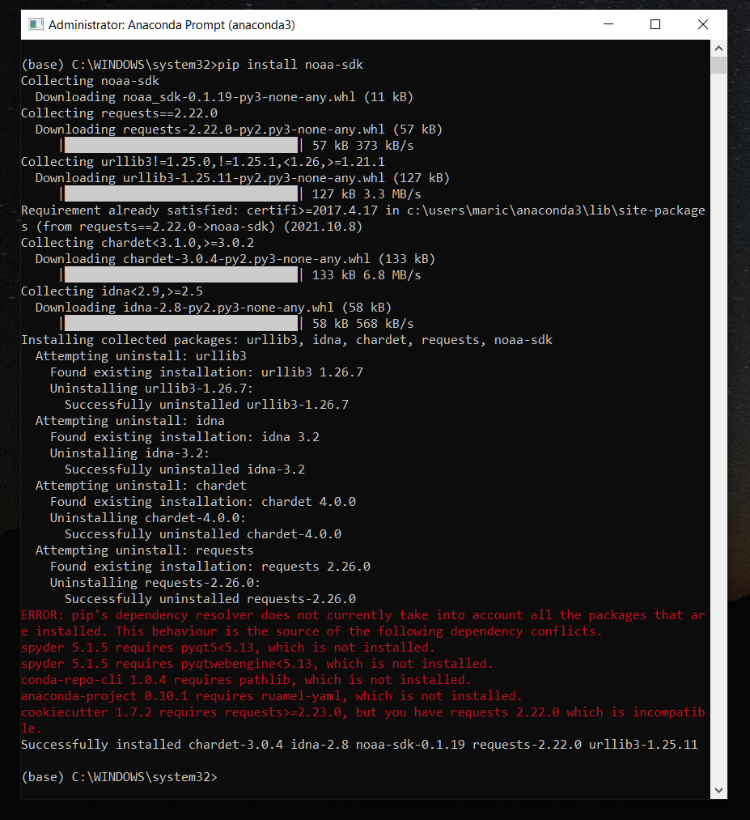
Software Inventory
Include screenshot of NOAA-SDK library installed
Ensure result "Successfully installed noaa-sdk" of pip install command is visible in your screenshot.

Slide 6
Downloading weather data
Using Python create and run a program to download a data set of recent weather observations for current location, create a database on the computer’s hard drive and store the weather data in a table for later analysis.

Slide 7
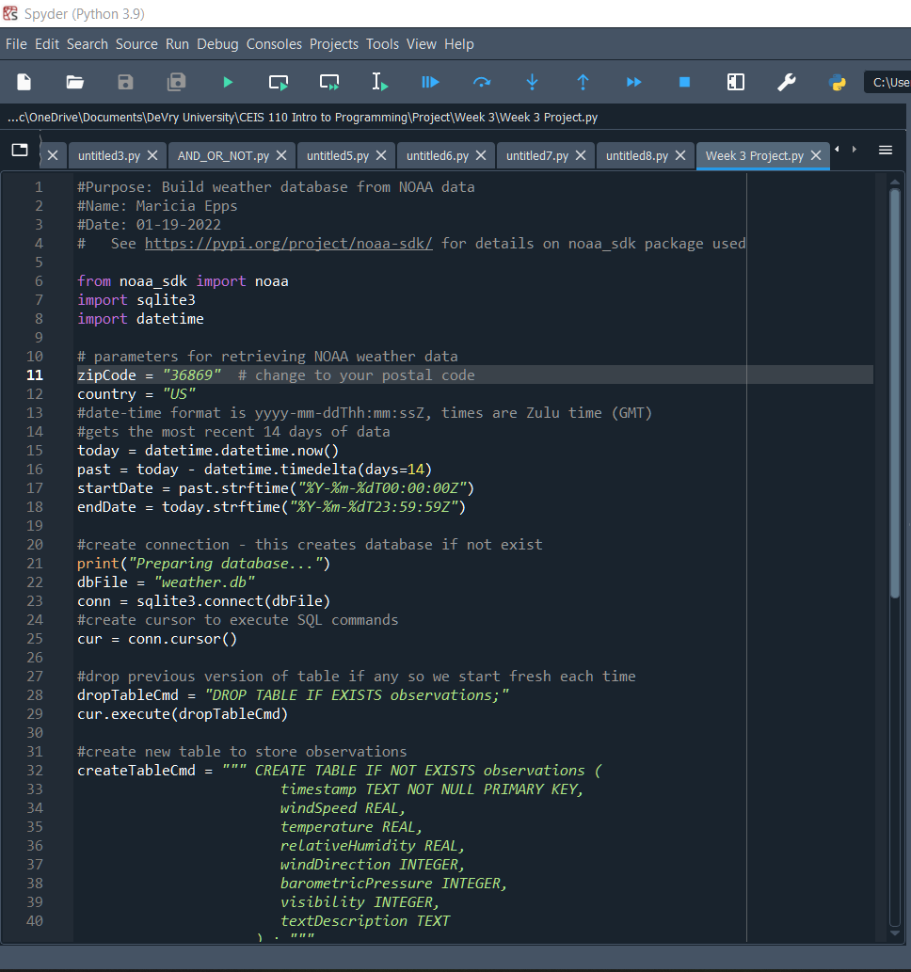
BuildWeatherDb.py Code
Screenshot of code in Spyder
Must have your name and date in comments
Must have your zip code

Slide 8
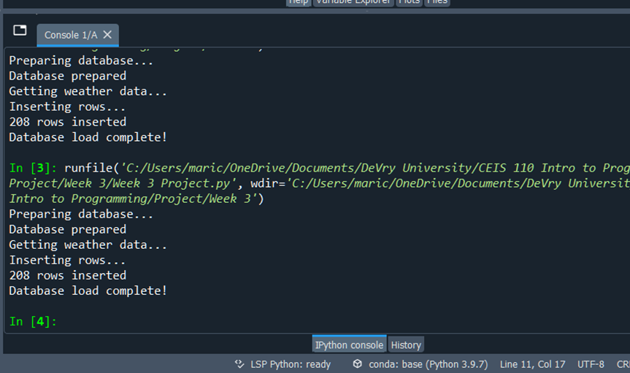
Python Console
Screenshot of program output in Python console showing program executed successfully

Slide 9
Weather.db File
Screenshot of Windows Explorer showing database file Weather.db was created

Slide 10
Querying the database with sql
Using Python issue SQL commands to the database and view the results.

Slide 11
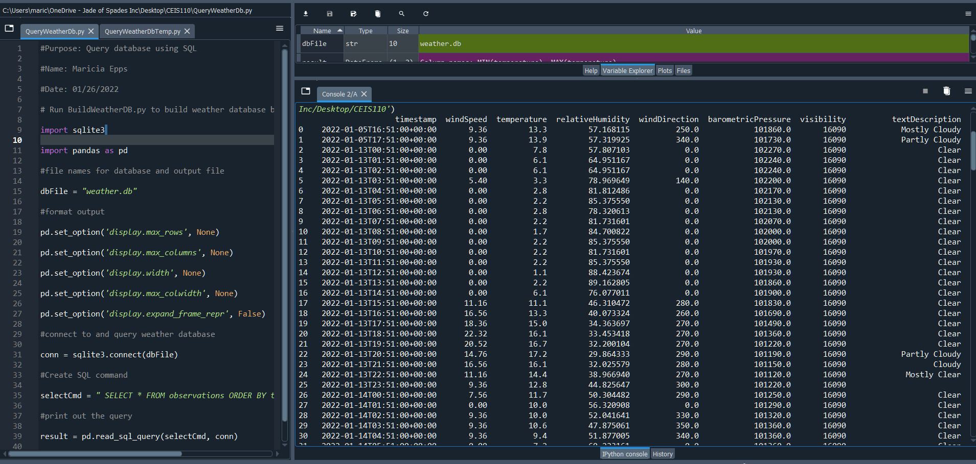
Query to retrieve all columns and all rows
Screenshot of SQL query command and results

Slide 12
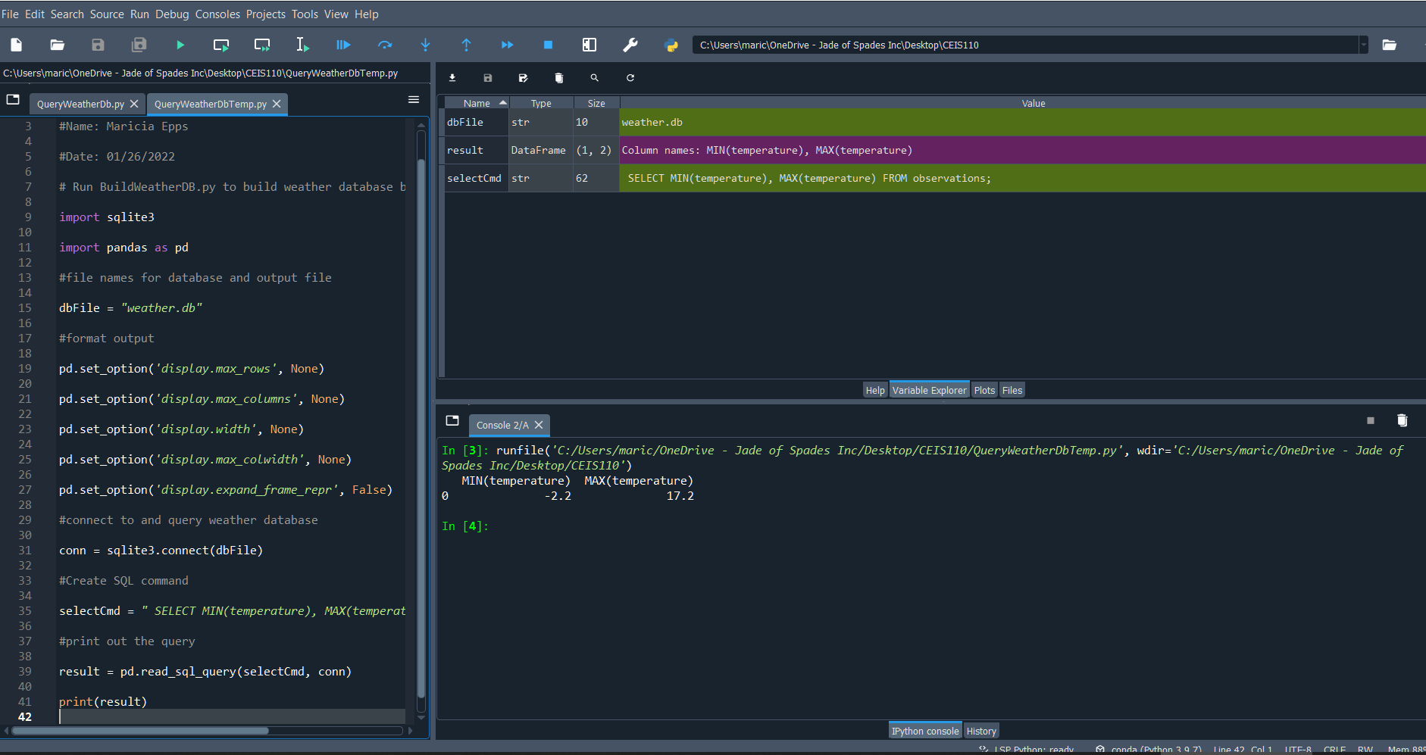
Query to retrieve lowest and highest temperatures
Screenshot of SQL query command and results

Slide 13
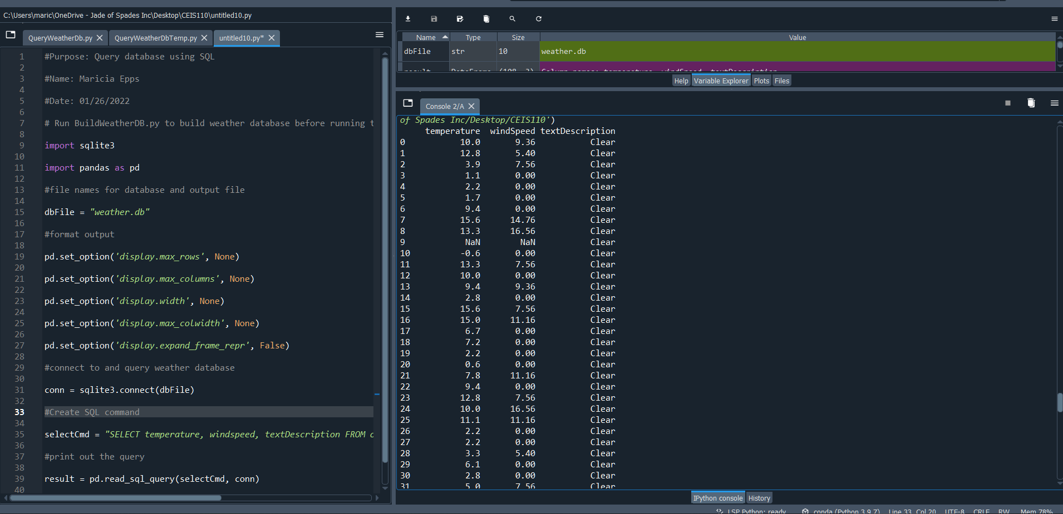
Query to retrieve all clear days
Screenshot of SQL query command and results

Slide 14
Querying and manipulating data with sql and python
Use SQL query embedded in the Python program to retrieve data from database and store it in Excel file.

Slide 15
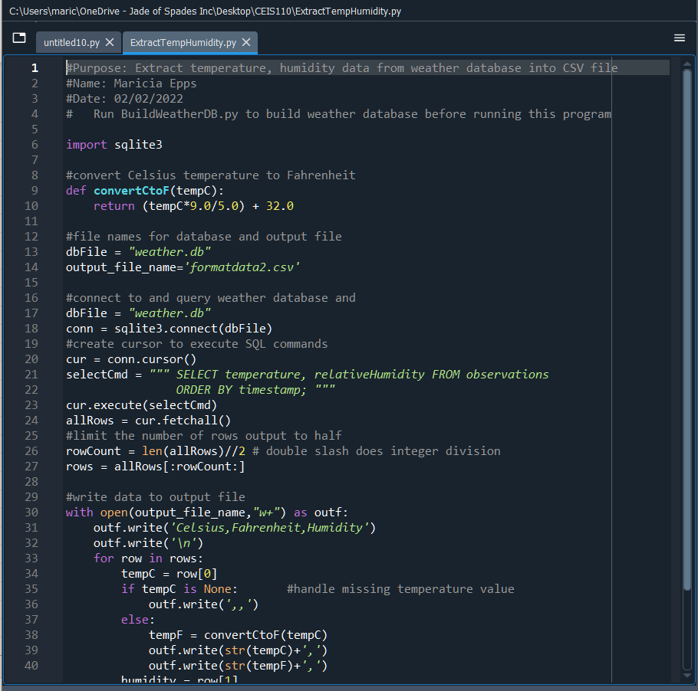
Python code
ExtractTempHumidity.py Python code with your name and date in comments

Slide 16
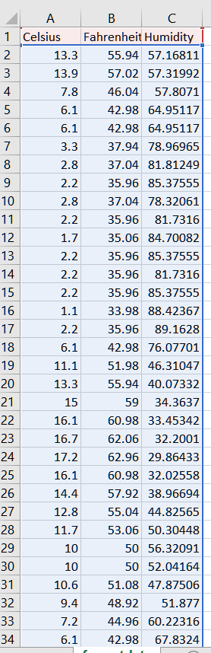
Retrieve and Convert Data to CSV Format
Formatdata file open in Excel showing 3 columns of data

Slide 17
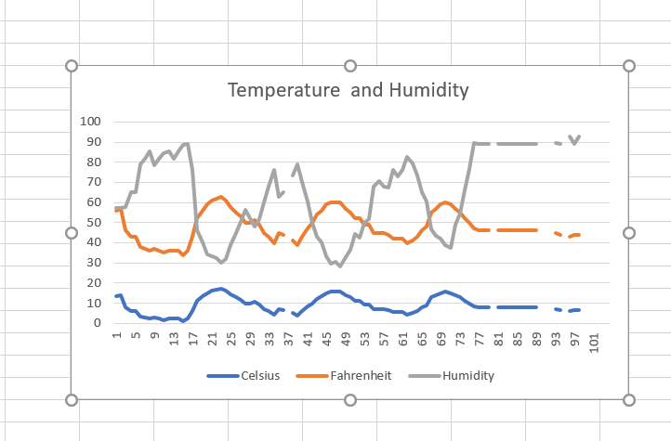
Temperature and Humidity Chart
Excel chart based on temperature and humidity data from database

Slide 18
Develop graphical models and interpret results
Use data analytics to interpret and analyze data from database.

Slide 19
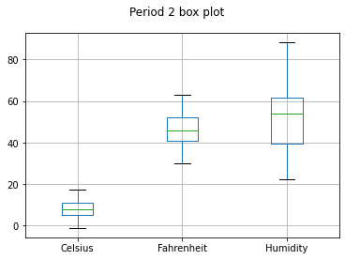
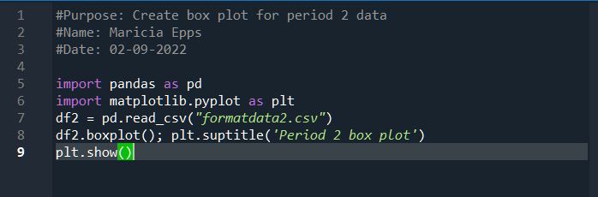
Plot #1

Slide 20
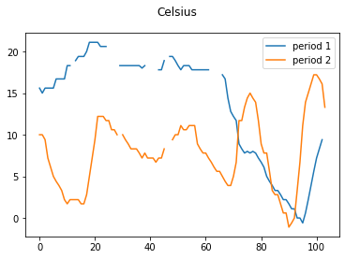
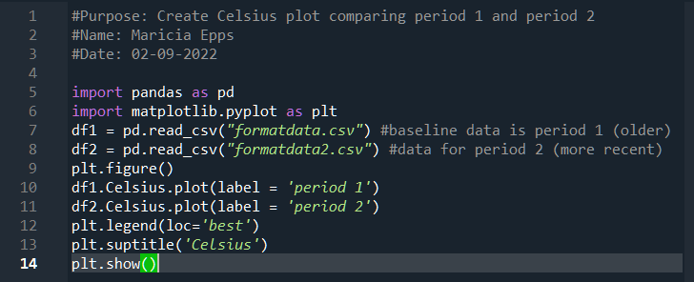
Plot #2

Slide 21
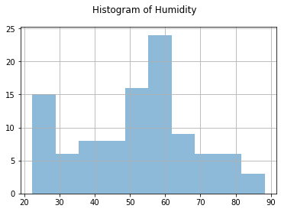
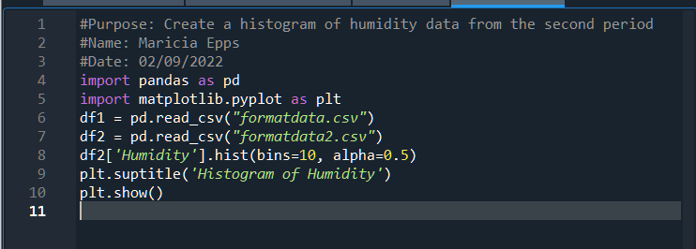
Analysis
Think of your own question and create a chart/graph to answer it
Is my area high in humidity or low in humidity during this week period?
Answer supported by Chart:
Based on the chart and the binned humidity data shows that I live in a moderately humid area.

Slide 22
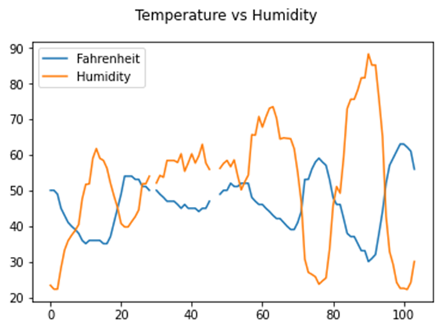
Prediction
Develop a prediction based on the data.
  What variations in temperature and humidity do you expect over the next few hours or days?
  How would humidity change if temperature goes up or down?
Based on my line chart, the temperature and humidity will probably continue to stay between 45 and 65 degrees.
Based on my line chart on the right, there is a reverse relationship between temperature and humidity.

Slide 23
conclusion
In this project using Python, I analyzed the weather data downloaded from a cloud data source, stored it in a database, extracted, processed, analyzed, and made predictions using that data.

Slide 24
Challenges
The challenge I faced with this project were ensuring the code was correct in order for my data to show accurately. I was receiving the same data for both sets of data. It was an error with my semicolons being in the incorrect place, upon further review and discussion with my professor we were able to resolve the error.

Slide 25
Career skills
Problem-solving
Communication
SQL
PHP
API
Data Structure
Attention to detail
Collaboration
Focus
Software Setup
Data Analysis
Python Programming

Slide 26
references
ZyBook
Live Instructor lead class

