Slide 1
Fundamental Laws of Physics
Maricia Epps

Slide 2
Introduction
This project will utilize an ultrasonic sensor to measure the free fall motion of an object. The data collected will be used to conduct an analysis on the conservation of energy. Next, a rotary encoder will be used to understand how linear motion is related to rotational motion. Finally, the Hall effect will be used to show the relationship between the electric and magnetic fields.

Slide 3
Materials List

Slide 4
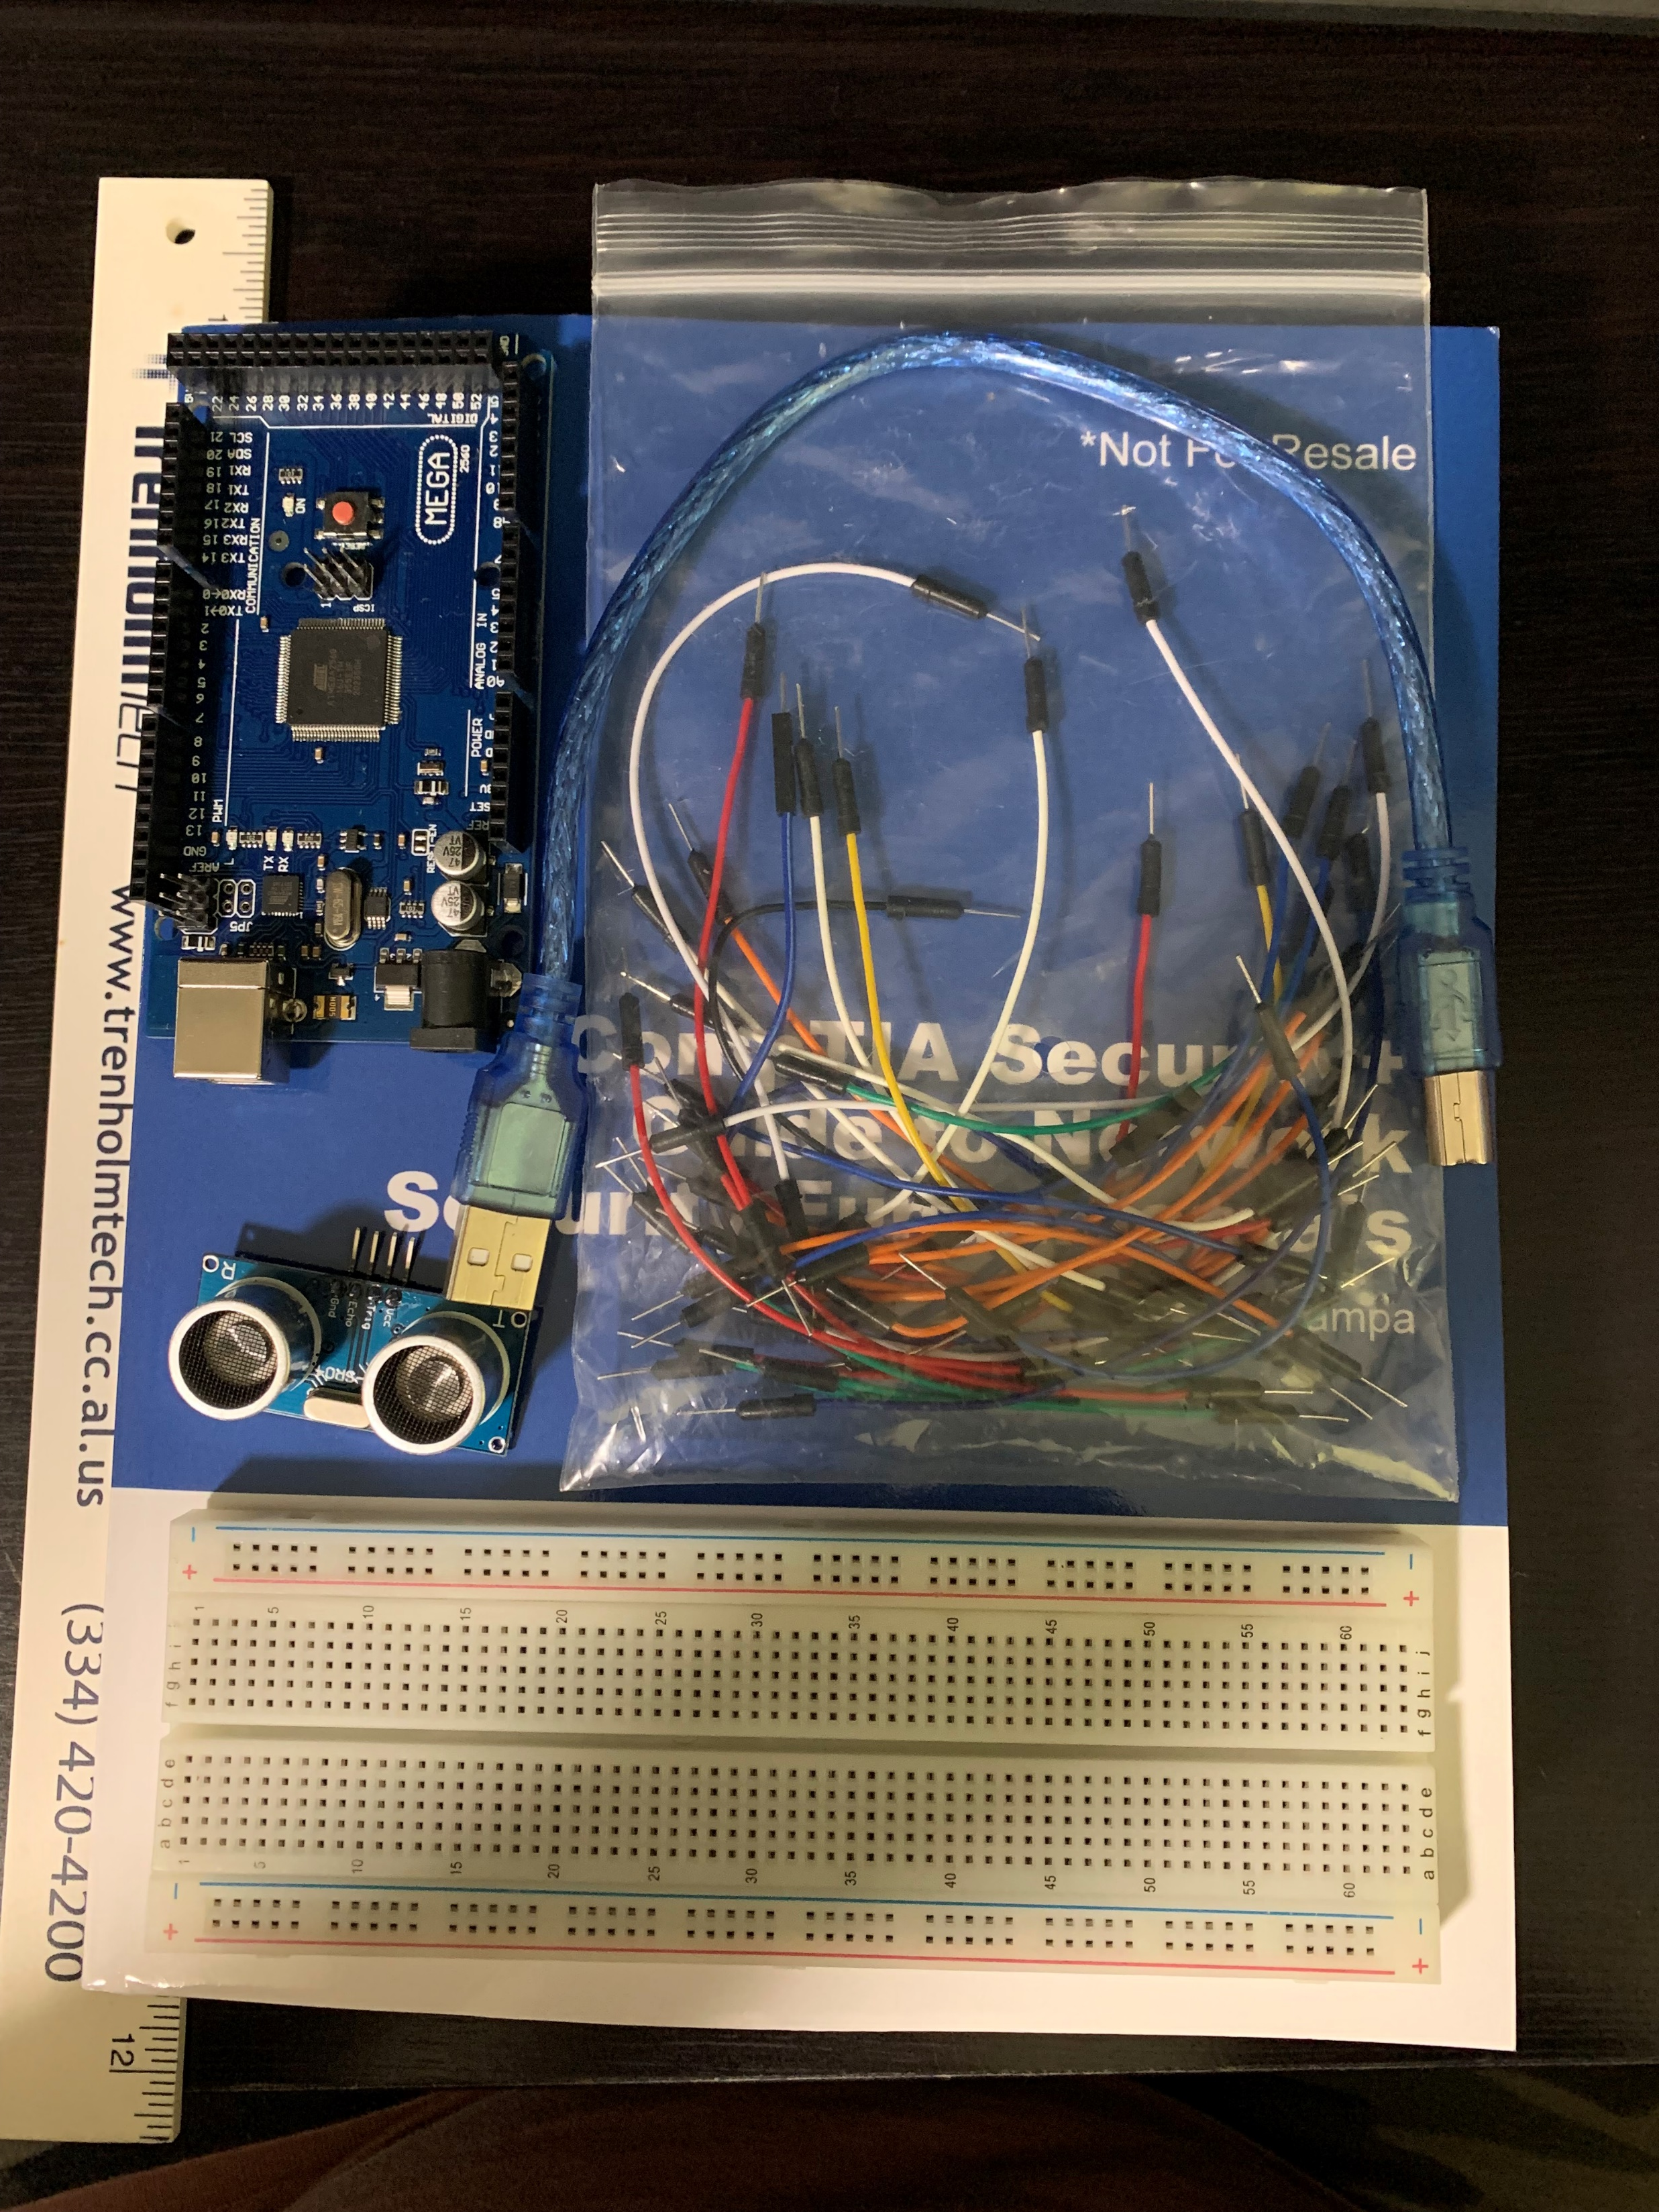
Materials List
Mega 2560 Board
Ultrasonic sensor HC-SR04
Male to Male Wires
Breadboard
USB cable
Ruler or tape measurer
Object to act as obstacle and/or undergo free-fall

Slide 5
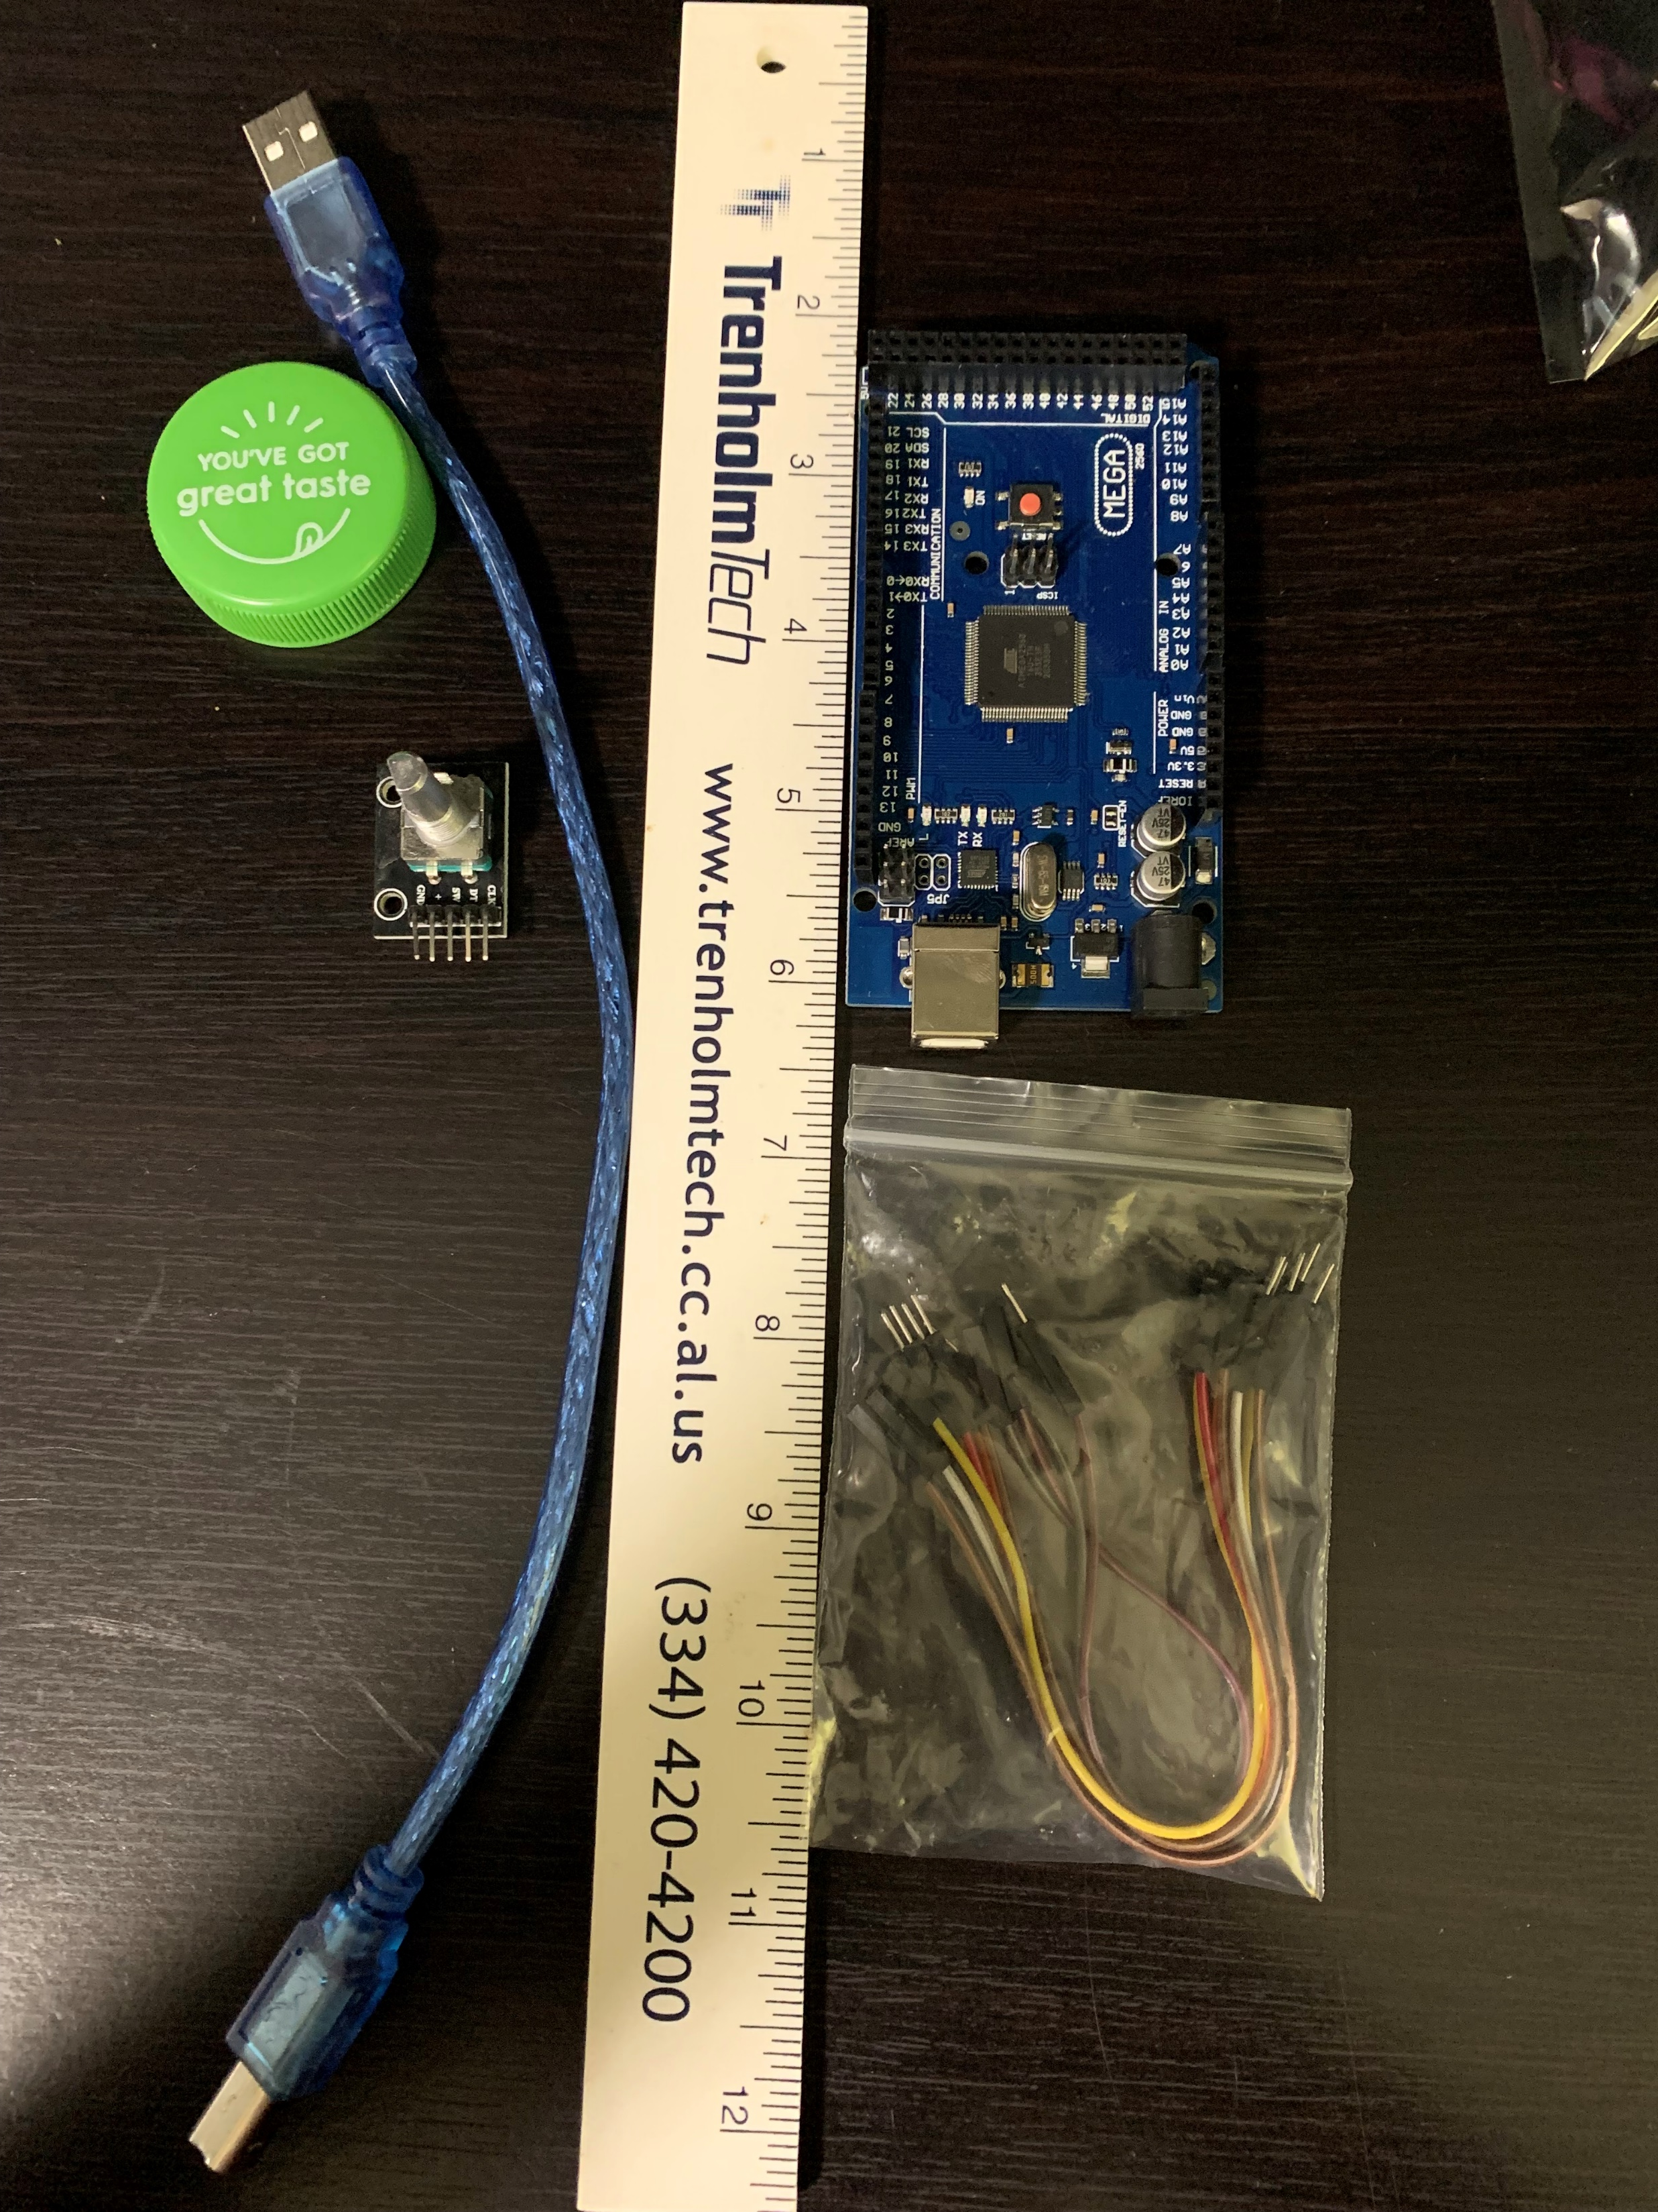
Materials List
Mega 2560 Board
Rotary Encoder Module KY-040
Male to Female Wires
USB cable
Object to attach onto rotary encoder
Ruler or tape measurer

Slide 6
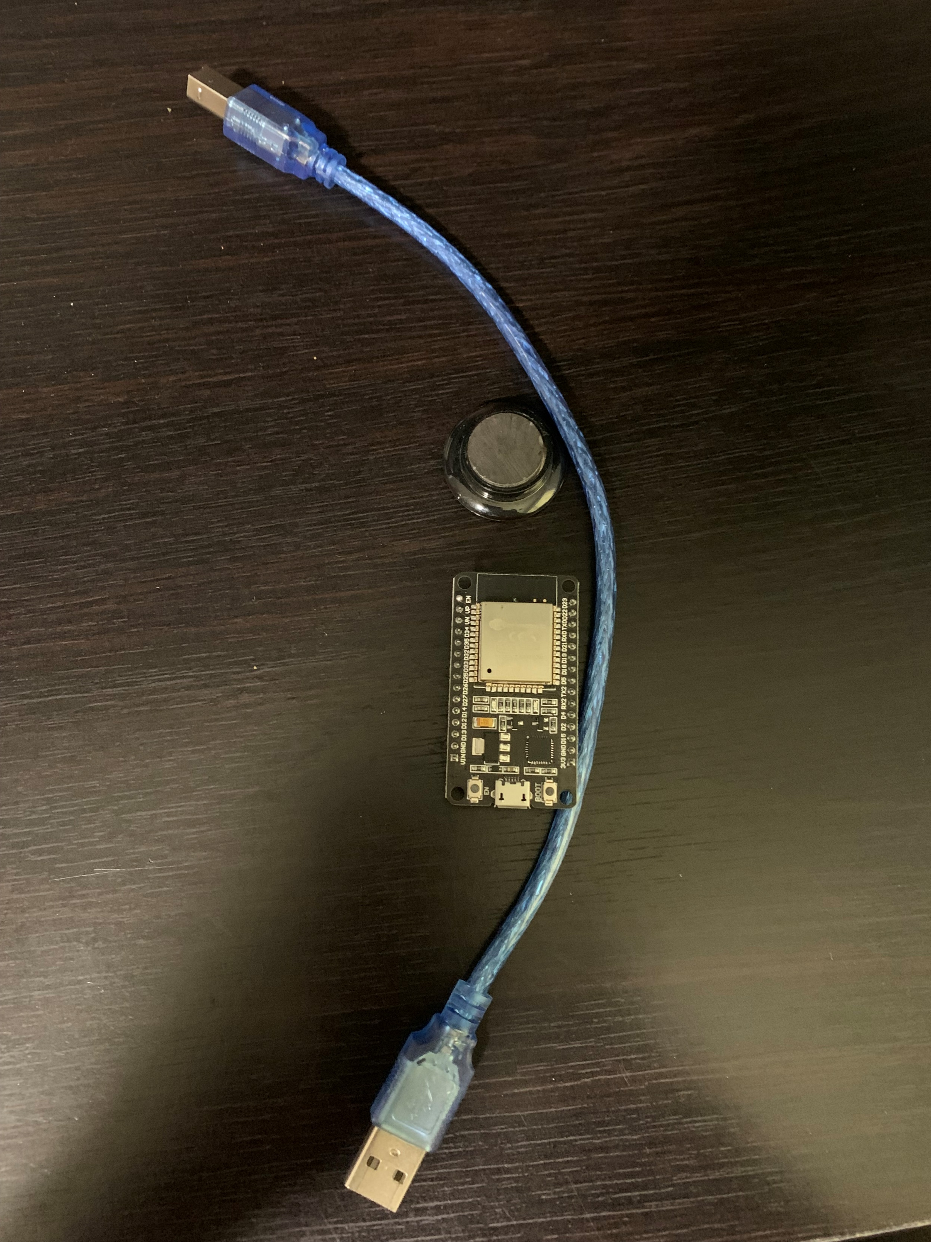
Materials List
ESP32 microprocessor
Micro-USB to USB cable
Magnet

Slide 7
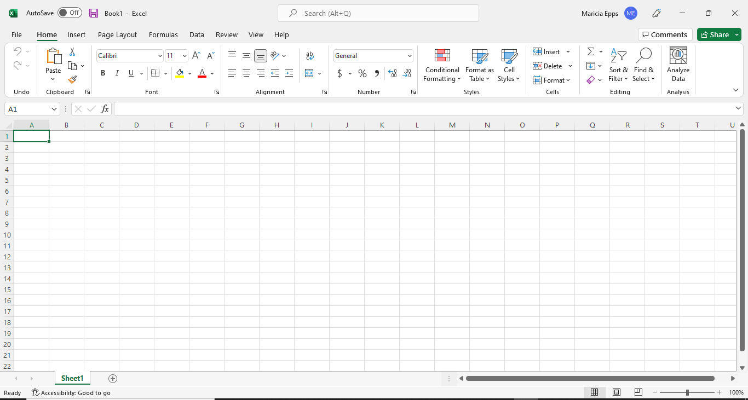
Required Software
Microsoft Excel installed and running

Slide 8
Required Software
Arduino IDE installed and running

Slide 9
Precision of the Ultrasonic Sensor

Slide 10
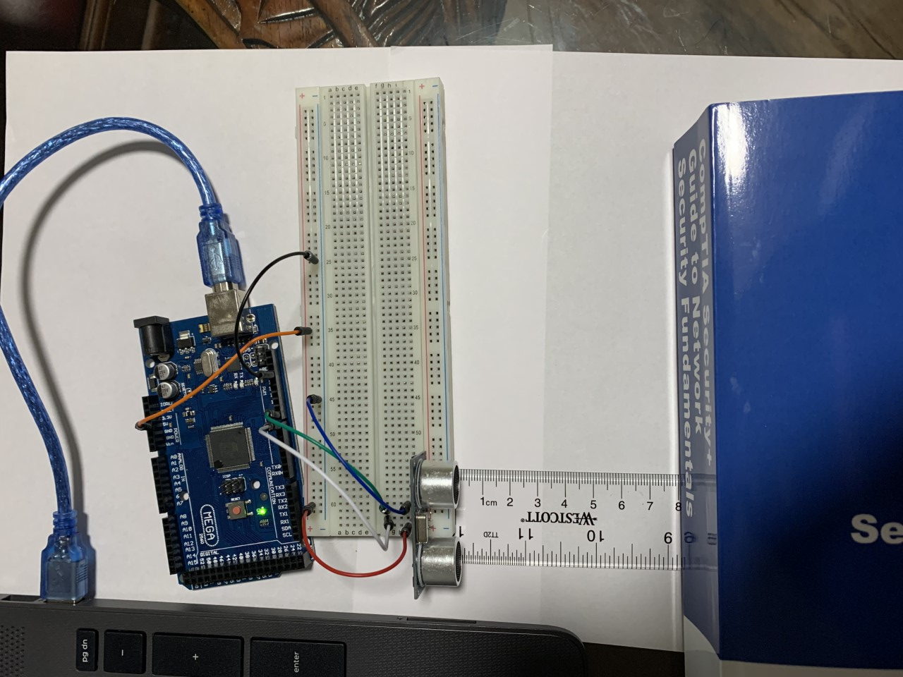
Experimental Set-up
Materials List:
Mega 2560 Board
Ultrasonic sensor HC-SR04
Male to Male Wires
Breadboard
Ruler or tape measurer
Object to act as obstacle

Slide 11
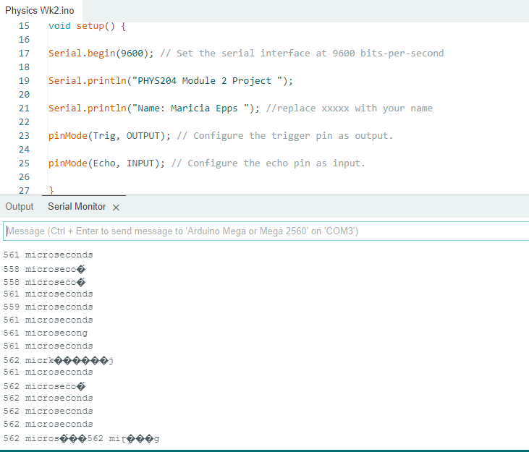
Raw Data
Screenshot of Serial Monitor from Arduino IDE showing raw data.

Slide 12
Data Collection
Trial | Ruler Distance (cm) | Total Roundtrip Distance (m) | Time from Serial Monitor (microseconds) | Roundtrip time (s) | Velocity = distance/time (m/s)
1 | 8 | 0.16 | 519 | 5.19e-4 | 308
2 | 5 | 0.10 | 364 | 3.64e-4 | 274
3 | 11 | 0.22 | 610 | 6.10e-4 | 360
4 | 4 | 0.08 | 219 | 2.19e-4 | 365
5 | 7 | 0.14 | 420 | 4.20e-4 | 333

Slide 13
Data Analysis
Average velocity from table
$v_{avg}= \frac{308+274+360+365+333}{5}=$ 328
Percent difference where $v_{sound}=343 m/s$
$Percent difference = \frac{\left|328−343\right|}{343}×100\%=$ 4.37%

Slide 14
Conclusions
Discuss the results and comment on the source of errors.
Answer: During this project my errors came from faulty wires and not having my sensor in the correct place. I also was not using my object properly and my data was not showing correctly. Upon further review of the errors, I was able to correct them and provide accurate data.
What is the dependence of temperature, humidity and atmospheric pressure on the speed of sound?
Answer: The cooler the temperature the slower the speed of sound and the higher the air temperature the faster the speed of sound. The lower the humidity the faster the speed of sound and the higher the humidity the slower the speed of sound moves.

Slide 15
Gravitational Acceleration

Slide 16
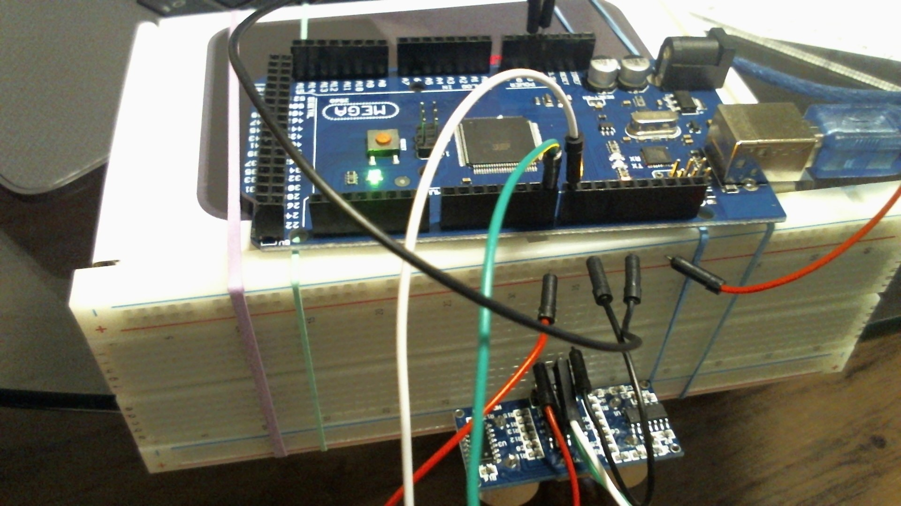
Experimental Set-up
Materials List:
Mega 2560 Board
Ultrasonic sensor HC-SR04
Male to Male Wires
Breadboard
Object to undergo free fall motion

Slide 17
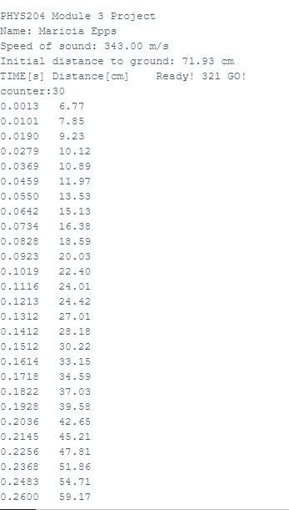
Serial Monitor
Raw data showing the start of the fall and end of the fall of one trial.

Slide 18
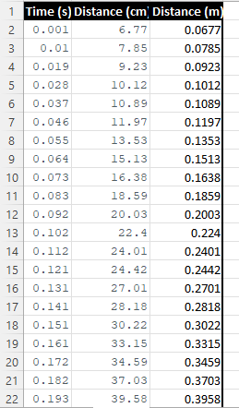
Excel Table
Includes all values in the Excel table for a single trial showing the fall distance in centimeters and meters as a function of time

Slide 19
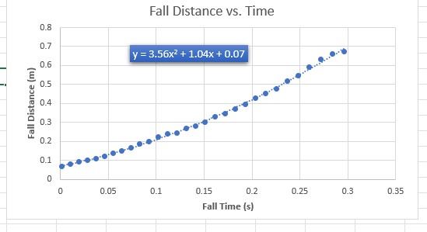
Excel Graph
Excel graph for a single trial showing the fall distance as a function of time.

Slide 20
Data Collection
Trial | x² coefficient value from curve fitting | Acceleration (m/s²) = 2* (x² coefficient)
1 | 3.56 | 7.12
2 | 4.16 | 8.32
3 | 6.04 | 12.08
4 | 6.63 | 13.26
5 | 4.24 | 8.48

Slide 21
Data Analysis
Average acceleration from table
$a_{avg}= \frac{7.12+8.32+12.08+13.26+8.48}{5}$ = 9.852m/s^2
Percent difference with $g=9.8 m/s^{2}$
$Percent difference =\frac{\left|9.852−9.8\right|}{9.8}×100\%=$ 0.5306%

Slide 22
Conclusions
Discuss the results and comment on the source of errors.
Answer: The errors in this experiment were due to the object rotating during the drop as well as the object dropping at different angles as well as the sensor calculating the unintentional movement of my hands.
How much variation is there from trial to trial? What does this indicate about the uncertainty of the result?
Answer: There was very little variation from trial to trial. The results will not be accurate because of all the outside factors that are outside of my control.

Slide 23
Conservation of Energy

Slide 24
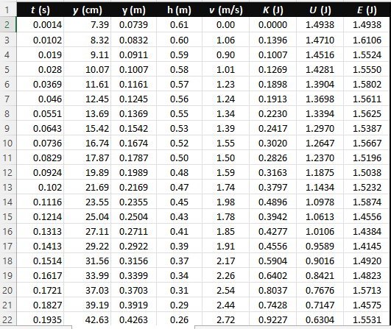
Excel Table
Included are all values in the Excel table for a single trial showing the fall distance in centimeters and meters as a function of time with the values generated for kinetic energy K, potential energy U, and total mechanical energy E.

Slide 25
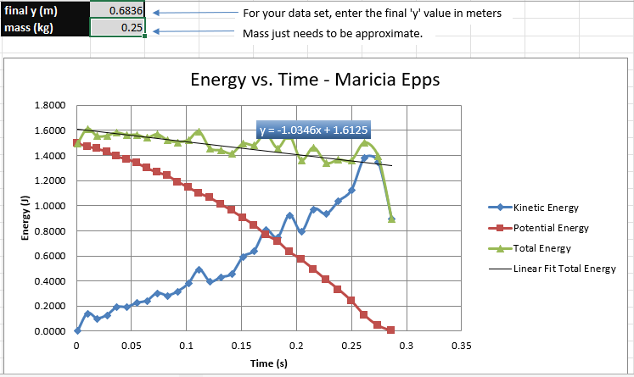
Excel Graph
Excel graph for a single trial showing the plots of the kinetic energy K, potential energy U, and total mechanical energy E as a function of time.

Slide 26
Data Validation
Final velocity from experimental data (largest velocity)
Theoretical value of final velocity.
$h=68.36−7.39=$ 60.97
$v_{f}=\sqrt{2∗9.80∗60.97}$ = 34.57
Percent difference
$v_{experimental}$ = 3.32
$$Percent difference =\frac{\left|34.57−3.32\right|}{34.57}×100\%=90.4\%$$

Slide 27
Conclusions
Discuss the key characteristics of the plot. Consider the times when U is max and min, when K is max and min, and when U and K are the same value. What is the significance of these points?
Answer: U is max at the beginning of the freefall and min when the fall as ended. K is max when the fall has ended and min when the freefall begins. They are the same when the object in freefall is at the midway point.
What is the trend of the best fit line for the total energy E in your data? If the data is accurate, the total mechanical energy should decrease slightly. Why is that?
Answer: The trend of the best fit line is a straight line. The mechanical energy will decrease because energy is being lost as the object falls to the ground.

Slide 28
Rotational Motion

Slide 29
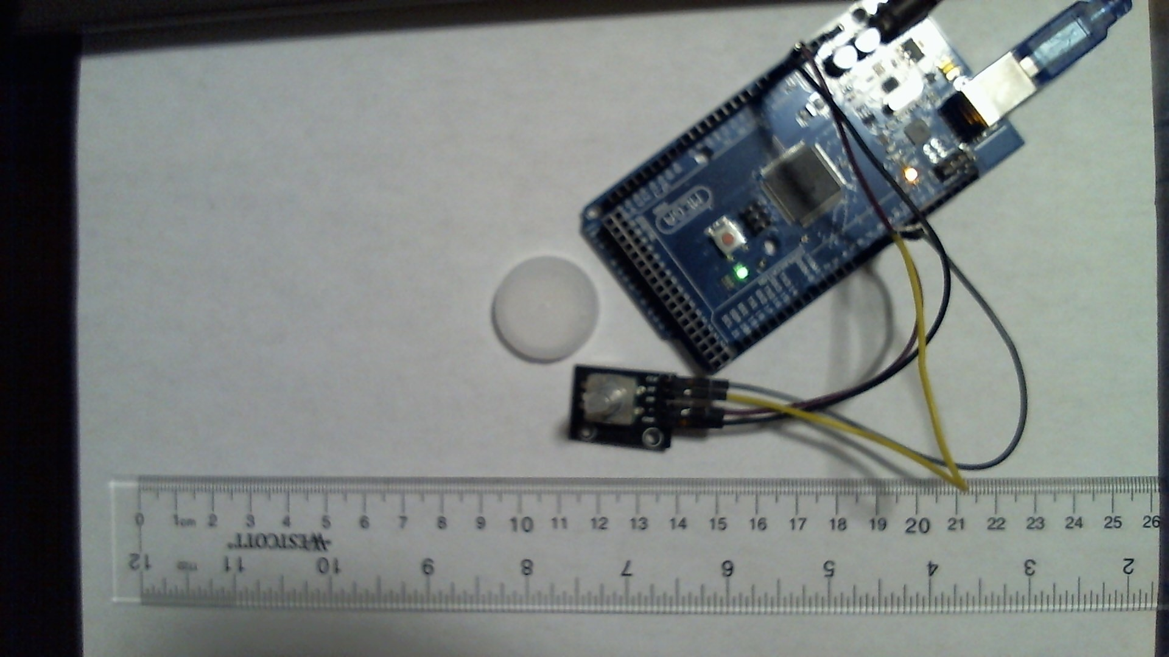
Experimental Set-up
Materials List:
Mega 2560 Board
Rotary Encoder Module KY-040
Male to Female Wires
Object to attach onto rotary encoder (e.g. cork, bottle cap, ball)
Ruler or tape measurer

Slide 30
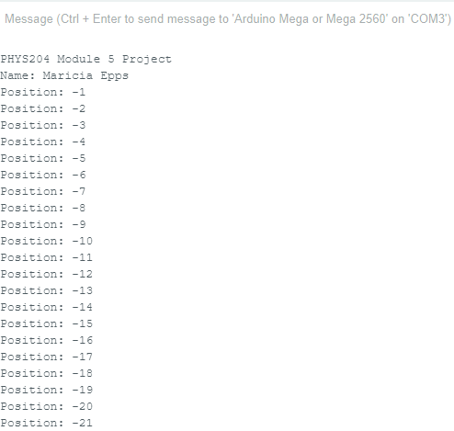
Raw Data
Serial Monitor from Arduino IDE showing raw data.

Slide 31
Data Collection
Object diameter: d = 4cm
Object radius: r = 2cm
Number of pulses for one revolution: x = 38
Resolution = $\left(\frac{1 }{x } \frac{Revolution}{pulses}\right)∙\left(\frac{2∙π radians}{1 Revolution}\right)=$ 0.165 radians

Slide 32
Data Analysis
Trial | Number of pulses N | Encoder distance r$∙Resolution∙$ N | Measured distance with ruler | Percent difference %
1 | 24 | 7.92 | 8cm | 1%
2 | 38 | 12.54 | 12cm | 4.5%
3 | 48 | 15.84 | 18cm | 12%
4 | 18 | 5.94 | 6cm | 1%
5 | 27 | 8.91 | 10cm | 10.9%

Slide 33
Conclusions
Discuss the results and comment on the reasons for errors.
Answer: The greater the distance rotated the greater the number of pulses to get to the chosen distance. The surface I used was a glass table. It was more slippery and smooth it also bevels at the rim which could have cause my data to have a greater precent of errors the further I went in distance.
What are some applications of this measuring technique? Could this measuring system be used to measure surfaces that are not flat?
Answer: I believe that it is possible to measure surfaces that are not flat, but you will probably have a greater percentage of error due to the shape of the object as well as the surface texture of the object.

Slide 34
Hall Effect

Slide 35
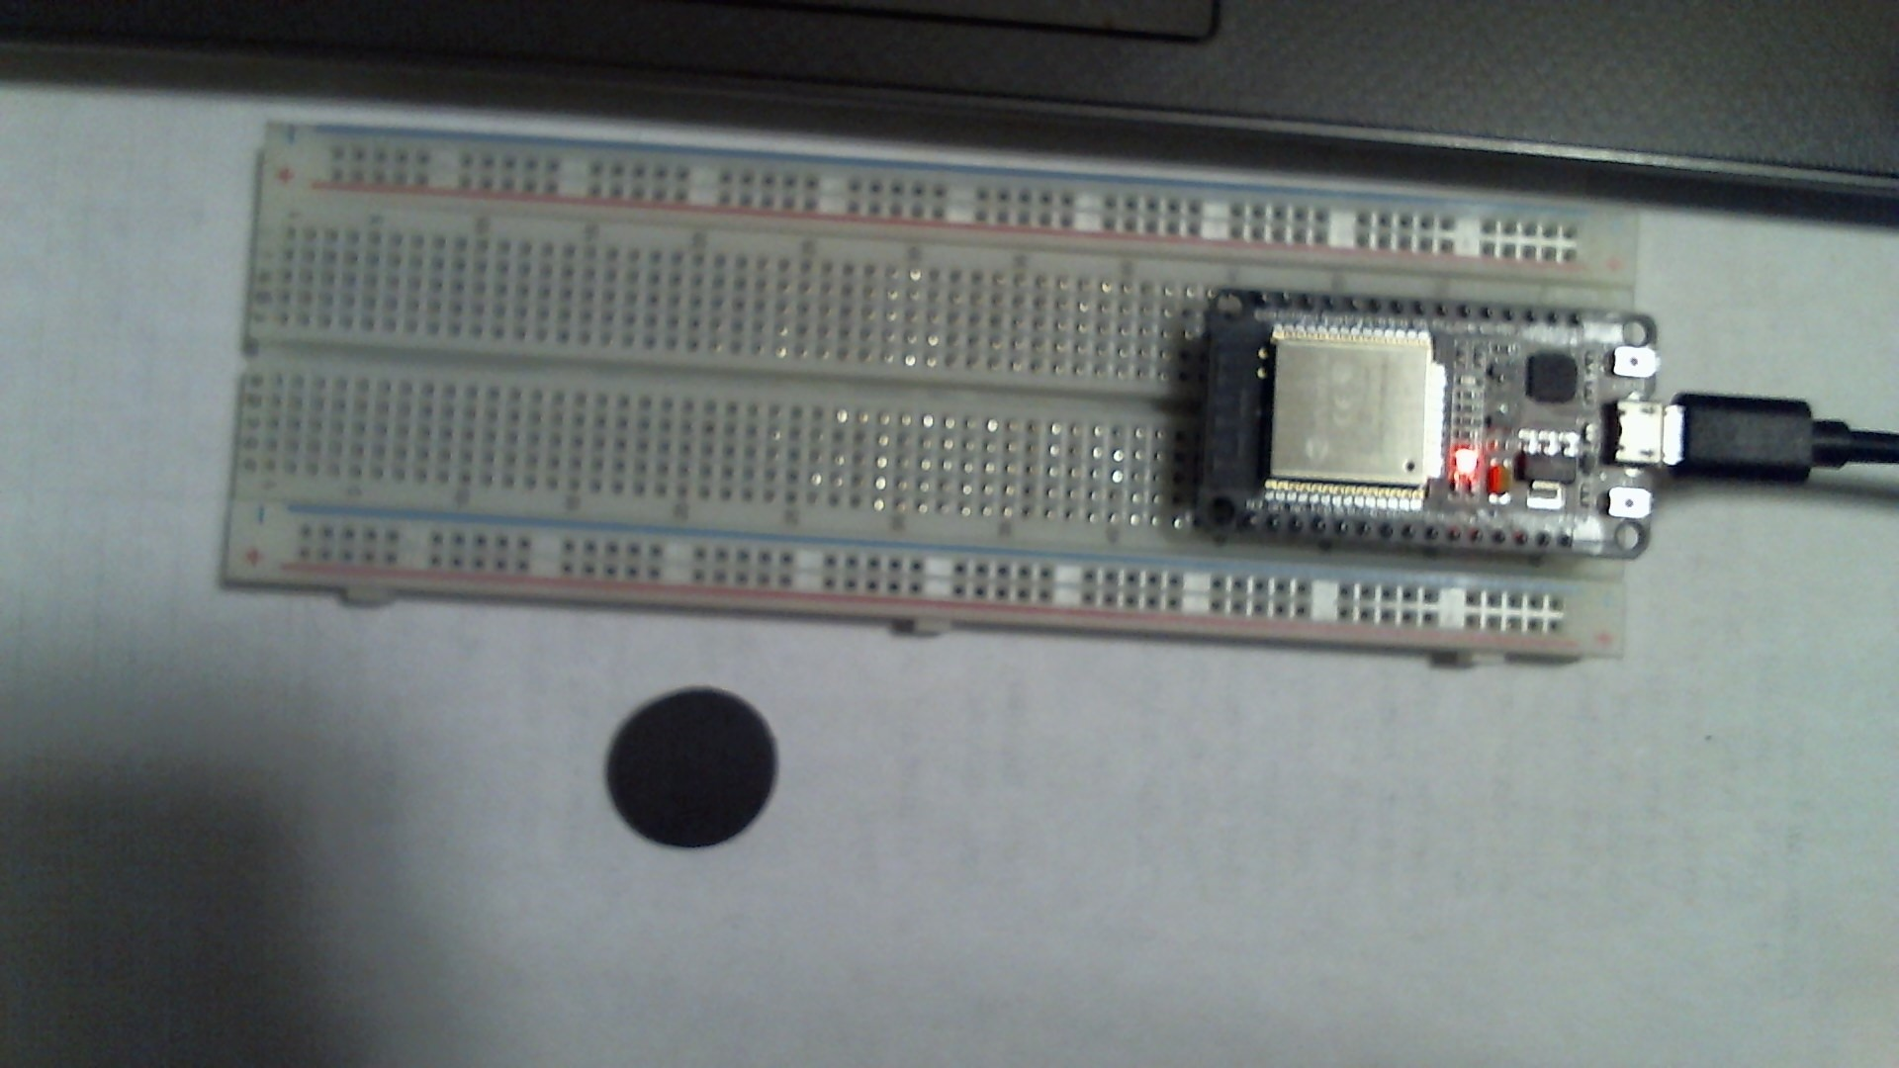
Experimental Set-up
Materials List:
ESP32 microprocessor
Micro-USB cable
Magnet

Slide 36
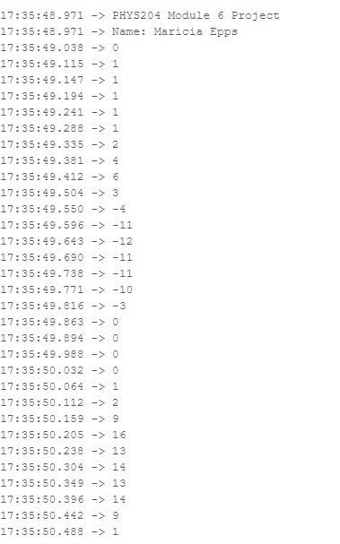
Raw Data
Serial Monitor from Arduino IDE showing raw data.

Slide 37
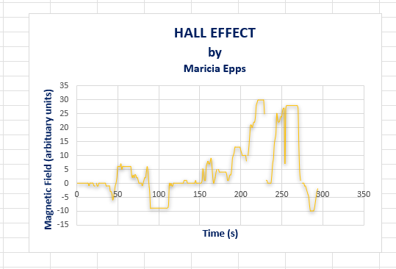
Data Analysis
Data plotted in Excel.

Slide 38
Conclusions
Discuss the results and comment on how the Hall sensor works.
Answer: Hall sensors work by detecting the presence, absence, or strength of the magnetic field around them. The results determined that the closer the magnetic presence to the sensor the greater the magnitude.
What are some applications for the Hall effect sensor?
Answer: These sensors can be used to help determine position, temperature, current, and pressure.

Slide 39
Challenges
Ensuring my object did not rotate while in free-fall.
Determining what may have happened to allow my error percentage to be either too high or low.
Ensuring my measurements and calculations were correct in correlation to my data.

Slide 40
Career Skills
Solving quantitative problems
Obtain, organize, analyze, and interpret scientific data
Prepare technical reports
Problem-solving

Slide 41
Summary
This project utilized an ultrasonic sensor to measure the free fall motion of an object and the data collected was used to conduct an analysis on the conservation of energy. The Hall effect was used to show the relationship between electric and magnetic fields. Physics describes the governing laws of the universe and with the IoT being a part of our daily lives we must understand physics to help build a better world with technology.

Slide 42
Thank You
Maricia Epps
maricia.epps@gmail.com
https://mariciaepps.wixsite.com/website

