Slide 1
Python Stock Tracking
Maricia Epps

Slide 2
Introduction
This project aimed to develop a stock tracking application. The purpose of the application is to process the historical stock data so that profit/loss reports can be generated. It will use data storage to save and retrieve stock data and libraries to create charts.

Slide 3
Software Environment Setup
Setup the environment used to develop the tracking application.

Slide 4
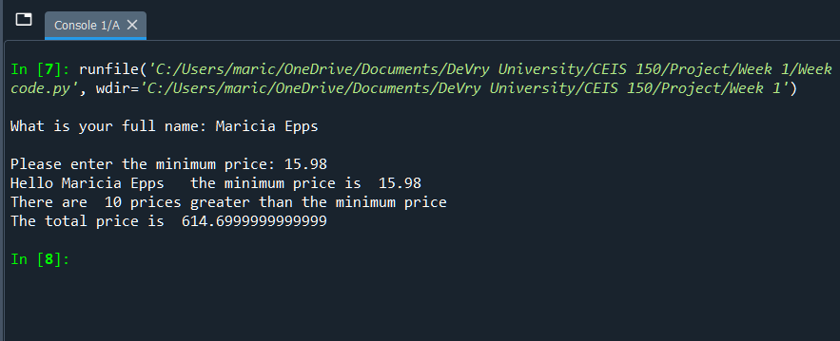
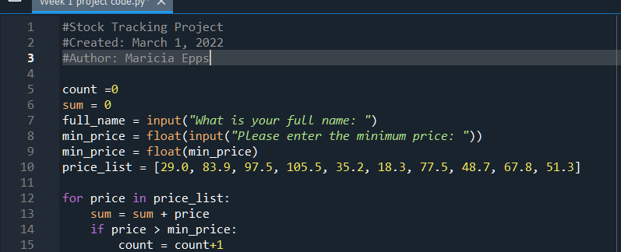
Program
Screenshot of Python program running successfully

Slide 5
Class
Create classes needed to work with the stock and history data.

Slide 6
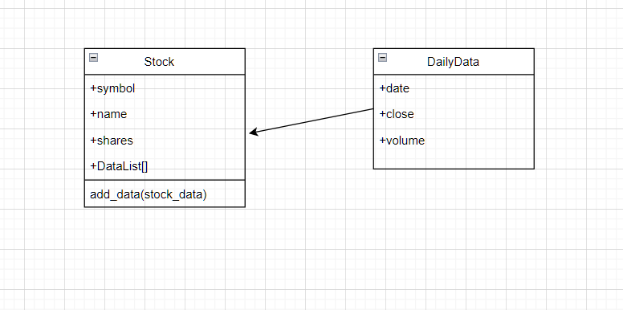
Class Diagram
Screenshot of Visio Class Diagram

Slide 7
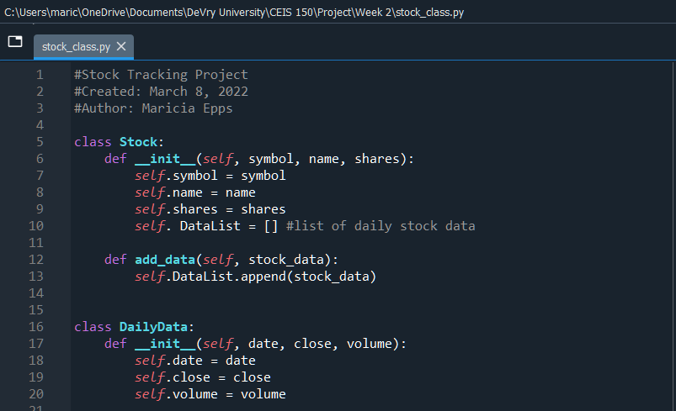
Class Code
Screenshot of stock_class.py file

Slide 8
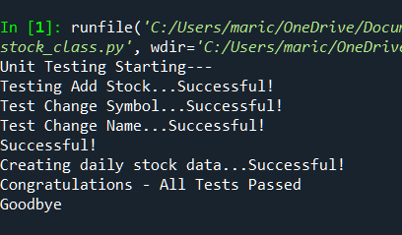
Unit Test
Screenshot of successful unit test

Slide 9
Console-Based Interface
To work with stocks and the stock price history.

Slide 10
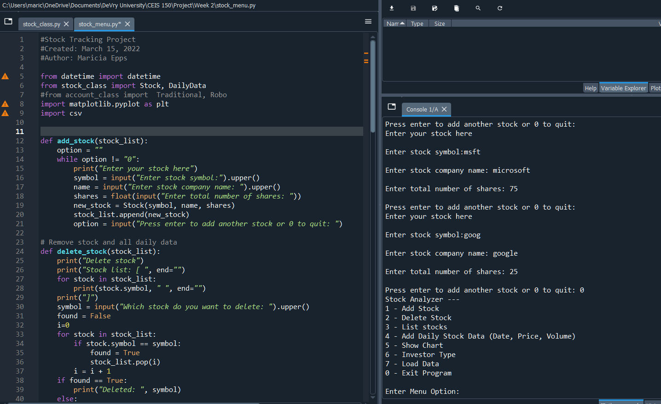
Adding a Stock
Screenshot of working Stock program

Slide 11
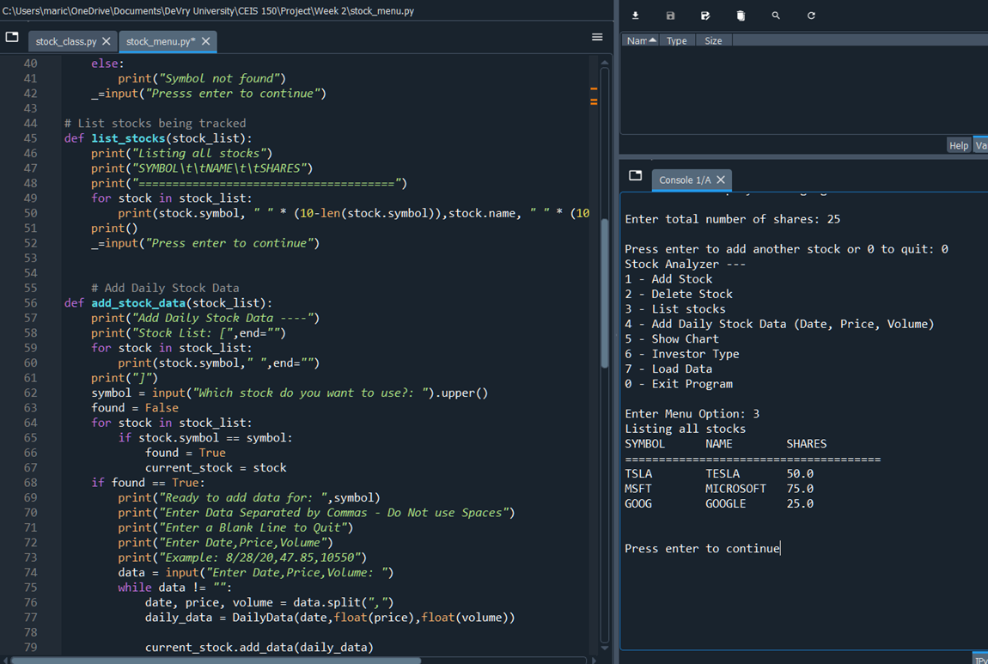
Listing 3 Stocks
Screenshot of working Stock program

Slide 12
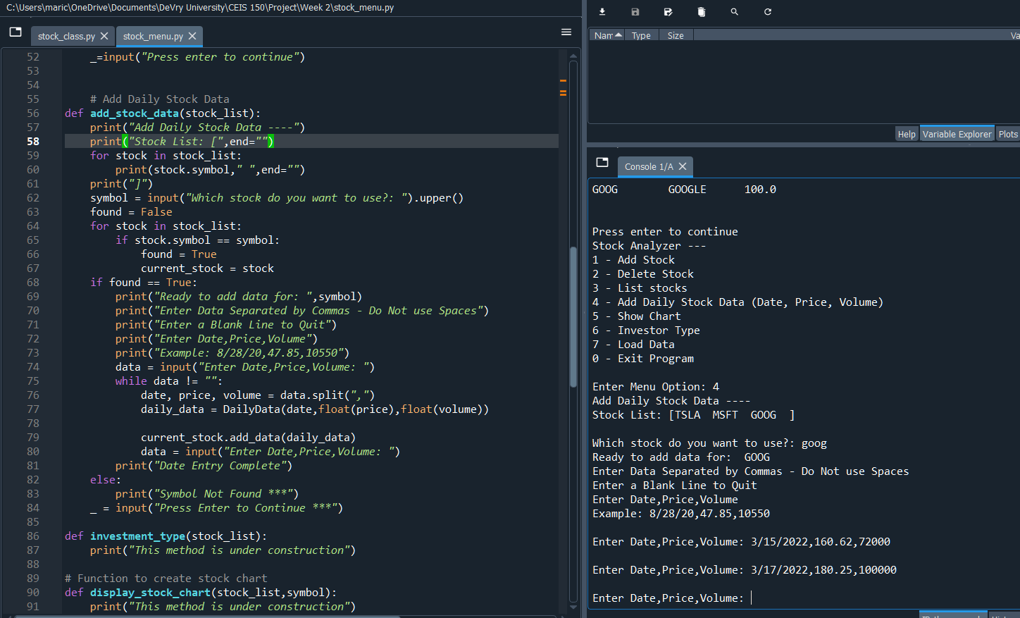
Daily Data
Screenshot of working Stock program

Slide 13
Inheritance
Create classes inherited from a base class.

Slide 14
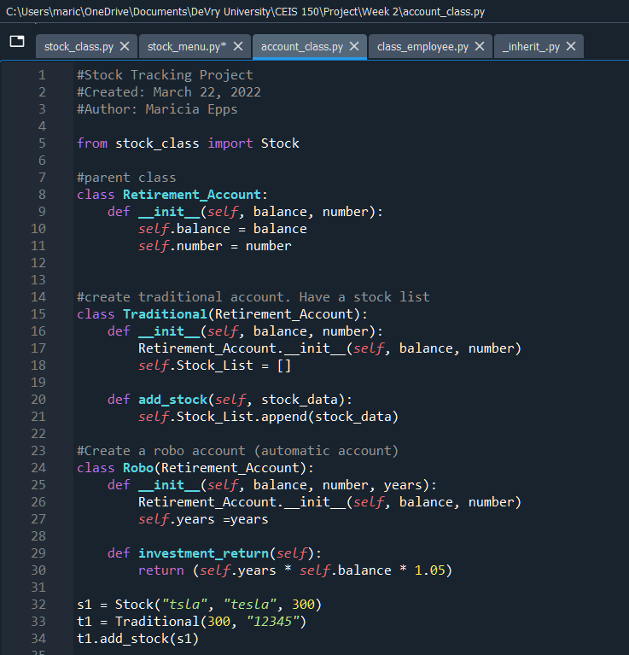
Inherited classes
Screenshot of classes

Slide 15
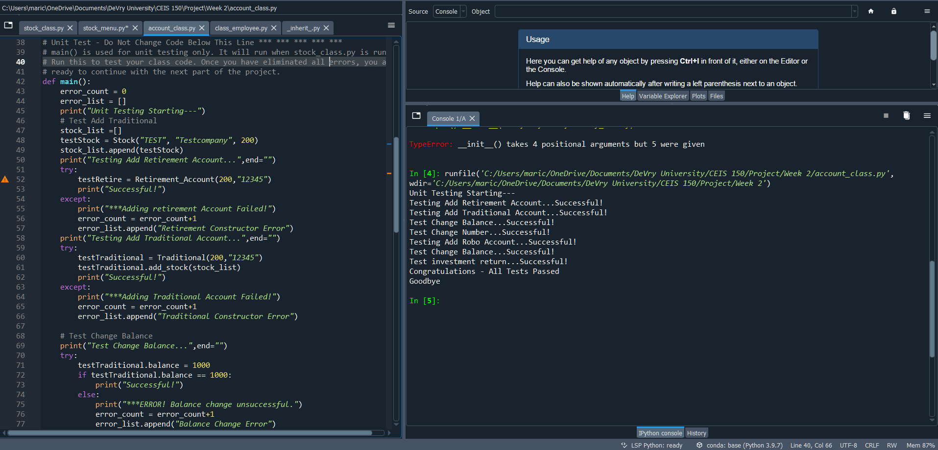
Unit Tests
Screenshot of unit tests successfully completed

Slide 16
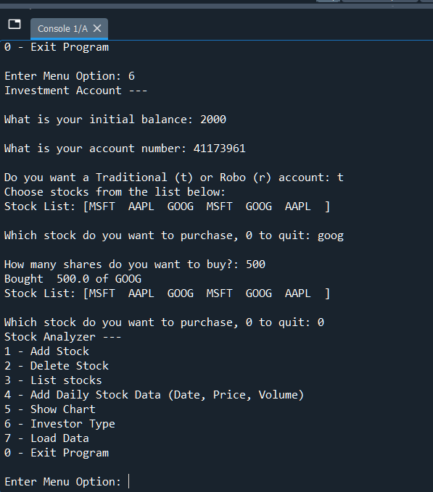
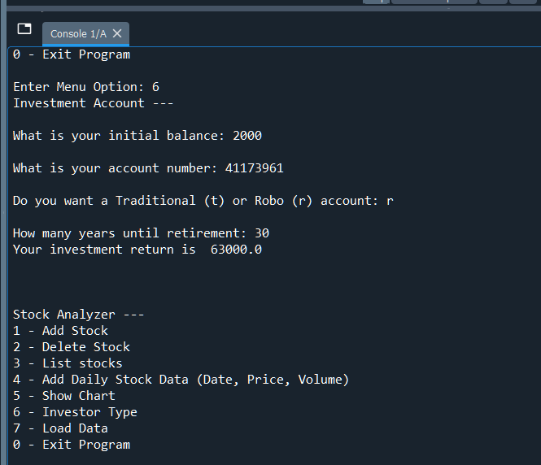
Stock menu program
Screenshot of classes in the main program

Slide 17
Chart
Created a chart using matplotlib.

Slide 18
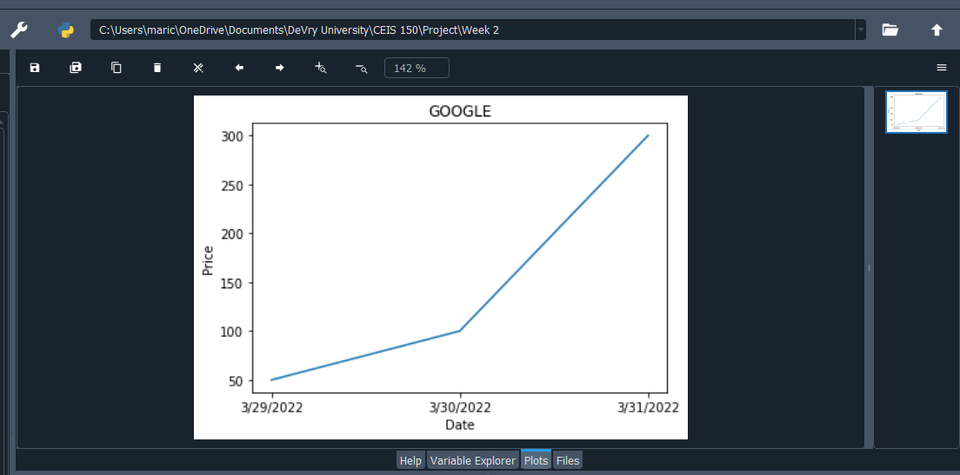
Chart
Screenshot of stock chart

Slide 19
Files
Saving and reading data from a csv file.

Slide 20
File
Screenshot of the file downloaded from Yahoo finance

Slide 21
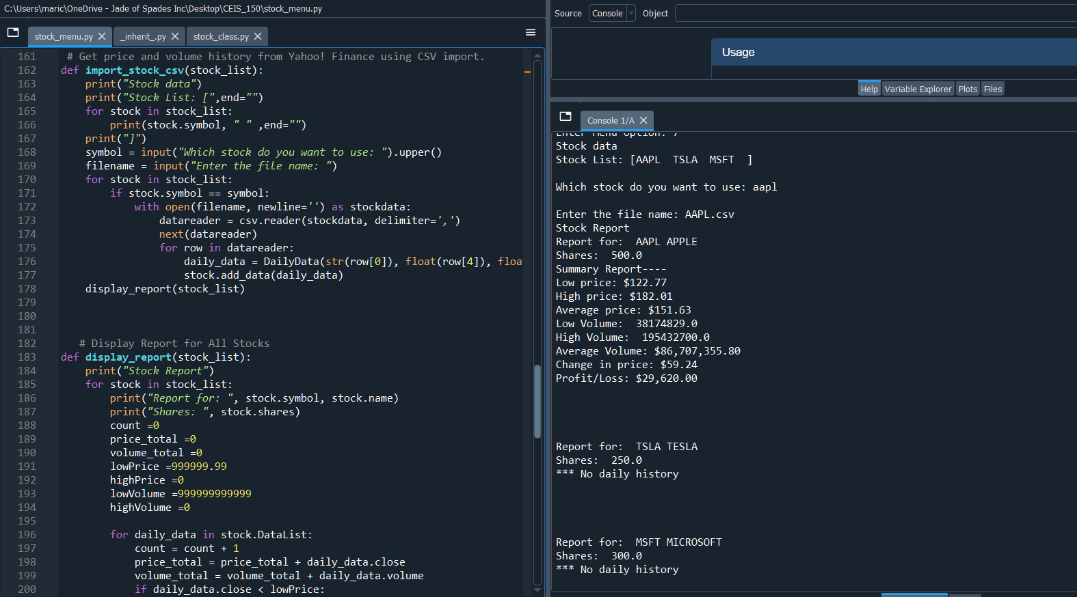
Importing data
Screenshot of the historical data import

Slide 22
Graphical User Interface (GUI)
Implemented a Stock Tracking GUI.

Slide 23
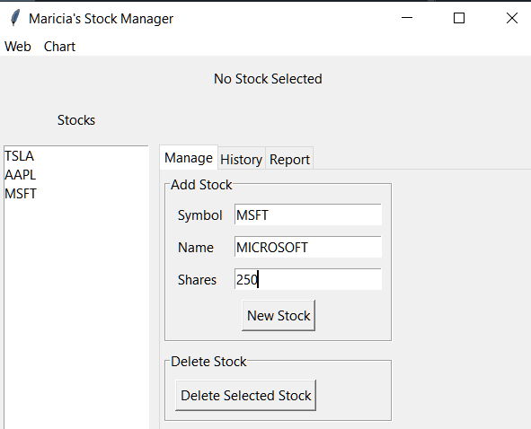
Stocks in GUI
Screenshot of GUI working

Slide 24
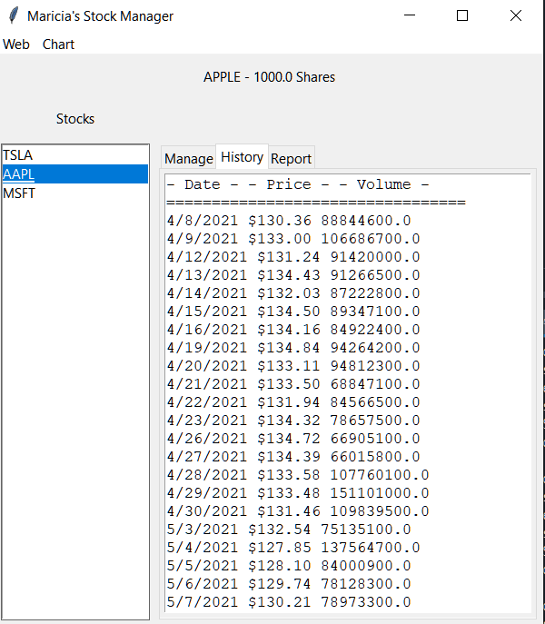
History Tab
Screen shot of History tab with import working

Slide 25
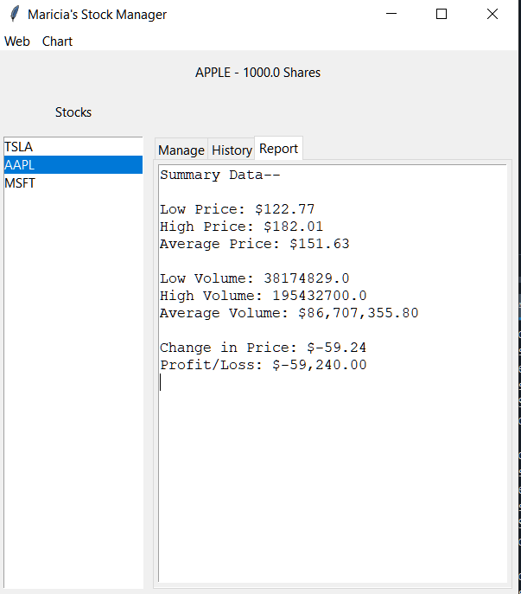
Report Complete
Screenshot of Report tab

Slide 26
Career Skills Developed
Creating classes
Inheritance
Encapsulation
Patience
Critical Thinking
Collaboration
Graphical User Interface (GUI)

Slide 27
Conclusion
Creating this project was fun and challenging. I allowed me to develop new skills and progress additional skills learned.

