Slide 1

Data Structures & Algorithms
Maricia Epps

Slide 2
Introduction
This project measured real-world algorithm speeds based on different scenarios by adding, pulling, displaying, and removing records. We used theoretical nomenclature, including Big-O notation. Theoretically, some algorithms are faster than others for certain tasks, and it is important to test the algorithm speeds using real-world data. Speeds are analyzed to determine the best scenarios for data structures.

Slide 3
ArrayList Real-World Speeds
Measure the speed of the ArrayList data structure using the following scenarios:
Printer Queue or Service Queue
Service Center
Call Center

Slide 4
TimeProcess.py
Python Code
Code:
# Name: Maricia Epps
# Date: March 3,2023
import time #use time library o time the code executions
# get current time before the process
start_time = time.time()
#run the process
for i in range (1000):
print ( "Hello Everyone!" )
# get current time after the process
end_time = time.time()
#subtract start time from end time to get time used by process
total_time = end_time - start_time
# Show the results. Note: .6f means "show six decimal places"
print ("\nSeconds run 1000 times: {:.6f}".format(total_time))
Test the following process speed:
Display “Hello Everyone” one thousand times.

Slide 5
Client.py
Python Code
Code: # Name: Maricia Epps
# Date: March 3, 2023
class Client:
def __init__(self, client_id=0, first_name="Unknown", last_name="Unknown", phone="Unknown", email="Unknown"):
self. __client_id = client_id
self.__first_name = first_name
self.__last_name = last_name
self.__phone = phone
self.__email = email
# classes that compare objects must implement __eq__ and __lt__ methods
# __lt__ means "less than" and it must return a boolean
# __eq__ means "equals" and it must return a boolean
def __lt__(self, other):
return self.__client_id < other.__client_id
def __eq__(self, other):
return self.__client_id == other.__client_id
# __str__() method is automatically called when you print the object
def __str__(self):
return str(self.__client_id) + ", " + self.__last_name + ", " + self.__first_name
# getters and setters
def get_client_id(self):
return self.__client_id
Attributes
  __client_id
  __first_name
  __last_name
  __phone
  __email
Behaviors
  __eq__
  __str__
Getters and Setters

Slide 6
Client.py
Python Code
Code Cont.:
def set_client_id(self, client_id):
self.__client_id = client_id
def get_first_name(self):
return self.__first_name
def set_first_name(self, first_name):
self.__first_name = first_name
def get_last_name(self):
return self.__last_name
def set_last_name(self, last_name):
self.__last_name = last_name
def get_phone(self):
return self.__phone
def set_phone(self, phone):
self.__phone = phone
def get_email(self):
return self.__email
def set_email(self, email):
self.__email = email
Attributes
  __client_id
  __first_name
  __last_name
  __phone
  __email
Behaviors
  __eq__
  __str__
Getters and Setters

Slide 7
ArrayListActualSpeed.py
Python Code
Code:
# Name: Maricia Epps
# Date: March 3, 2023
from ArrayList import ArrayList
from Client import Client
from Quicksort import Quicksort
from datetime import date
import time # use this library to time the code executions
import random # use to generate random number
import sys # use to terminate the application early
# display name and date in output
print("Name:", "Maricia Epps")
print("Date:", date.today())
print()
# create a list
clients = []
# read the records from the ClientData.csv file
#into Client objects and place the Client objects into the list
input_file_name = 'ClientData.csv'
with open(input_file_name) as infile:
Read records into application.
Test the following process speeds:
  Add records to beginning of data structure
  Add records to end of data structure
  Add records to middle of data structure
  Retrieve records from beginning of data structure
  Retrieve records from end of data structure
  Retrieve records from middle of data structure

Slide 8
ArrayListActualSpeed.py
Python Code
Code Cont.:
for line in infile:
# split the line based on the commas
s = line.split(',')
client_id = int( s[0] ) #convert the default string to an int
f_name = s[1]
l_name = s[2]
phone = s[3]
email = s[4]
# create a client object using the data from the file
clt = Client(client_id, f_name, l_name, phone, email)
# add the client object to the list
clients.append(clt)
# sort the clients list
Quicksort.sort(clients)
# how many client objects do we have?
num_records = len(clients)
# create an ArrayList object
my_array_list = ArrayList()
# Scenario 1: Printer Queue or Call Queue
section_title = "Scenario: Printer or Call Queue"
print(section_title)
print("-" * len(section_title))
Read records into application.
Test the following process speeds:
  Add records to beginning of data structure
  Add records to end of data structure
  Add records to middle of data structure
  Retrieve records from beginning of data structure
  Retrieve records from end of data structure
  Retrieve records from middle of data structure

Slide 9
ArrayListActualSpeed.py
Python Code
Code Cont.:
# how long does it take to add the client records to the ArrayList?
start_time = time.time()
for i in range(num_records):
my_array_list.append(clients[i])
end_time = time.time()
total_time = end_time - start_time
print("Seconds to add records: {:.6f}".format(total_time))
# how long does it take to remove records from the front of the ArrayList?
start_time = time.time()
for i in range(num_records):
my_array_list.remove_at(0)
end_time = time.time()
total_time = end_time - start_time
print("Seconds to remove records from front: {:.6f}".format(total_time))
# Scenario 2: Customer Service Center
answer = input("Continue (y/n)? ")
if answer.lower() != "y":
sys.exit() # end the application
Read records into application.
Test the following process speeds:
  Add records to beginning of data structure
  Add records to end of data structure
  Add records to middle of data structure
  Retrieve records from beginning of data structure
  Retrieve records from end of data structure
  Retrieve records from middle of data structure

Slide 10
ArrayListActualSpeed.py
Python Code
Code Cont:
section_title = "Scenario: Customer Service Center"
print(section_title)
print("-" * len(section_title))
# add clients to the ArrayList
for i in range(num_records):
my_array_list.append(clients[i])
# how long does it take to randomly disply 1000 records?
start_time = time.time()
for i in range(1000):
smallest_id = 100001
largest_id = smallest_id + num_records
random_num = random.randint(smallest_id, largest_id)
#print( my_array_list.search(Client(random_num)))
print( my_array_list.search_sorted(Client(random_num)))
end_time = time.time()
total_time = end_time - start_time
print("Seconds to display random records: {:.6f}".format(total_time))
# Scenario 3: Call Center
answer = input("Continue (y/n)? ")
if answer.lower() != "y":
sys.exit() # end the application
section_title = "Scenario: Call Center"
print(section_title)
print("-" * len(section_title))
# how long does it take to add records, randomly disply 1000 records
# and randomly remove 1000 records?
start_time = time.time()
Read records into application.
Test the following process speeds:
  Add records to beginning of data structure
  Add records to end of data structure
  Add records to middle of data structure
  Retrieve records from beginning of data structure
  Retrieve records from end of data structure
  Retrieve records from middle of data structure

Slide 11
ArrayListActualSpeed.py
Python Code
Code Cont:
#add records
current_id = 100001 + num_records + 1
for i in range(1000):
my_array_list.append(Client(current_id))
current_id += 1
# display random records
for i in range(1000):
smallest_id = 100001
largest_id = smallest_id + num_records
random_num = random.randint(smallest_id, largest_id)
#print( my_array_list.search(Client(random_num)))
print( my_array_list.search_sorted(Client(random_num)))
# remove random records
for i in range(1000):
smallest_id = 100001
largest_id = smallest_id + num_records
random_num = random.randint(smallest_id, largest_id)
print( my_array_list.search(Client(random_num)))
end_time = time.time()
total_time = end_time - start_time
print("Seconds to add, display, and remove records: {:.6f}".format(total_time))
Read records into application.
Test the following process speeds:
  Add records to beginning of data structure
  Add records to end of data structure
  Add records to middle of data structure
  Retrieve records from beginning of data structure
  Retrieve records from end of data structure
  Retrieve records from middle of data structure

Slide 12
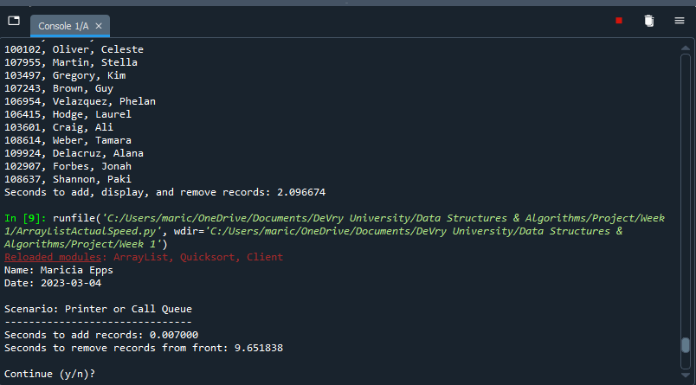
Screenshot of
Running Code
This is a screenshot of the ArrayListActualSpeed.py code running for the Printer or Call Queue Scenario with 1,000 records.

Slide 13
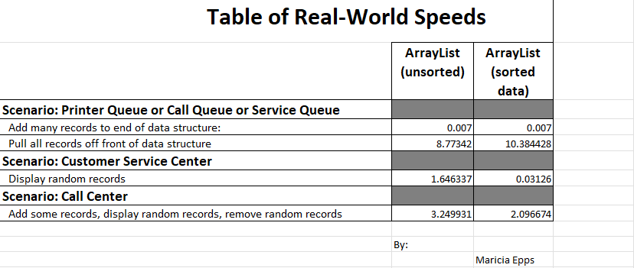
Table of Speeds
Printer Queue or Call Queue or Service Queue
  Add many records to end of data structure
  Pull all records off front of data structure
Customer Service Center
  Display random records
Call Center
  Add some records
  Display random records
  Remove some records

Slide 14
LinkedList Real-World Speed
Measure the speed of the LinkedList data structure using the following scenarios:
Printer Queue or Service Queue
Service Center
Call Center

Slide 15
LinkedListActualSpeed.py
Python Code
Code:
# Name: Maricia Epps
# Date: March 8, 2023
from LinkedList import LinkedList
from Client import Client
from datetime import date
import time # use this library to time the code executions
import random # use to generate random number
import sys # use to terminate the application early
# display name and date in output
print("Name:", "Maricia Epps")
print("Date:", date.today())
print()
# create a list
clients = []
# read the records from the ClientData.csv file
#into Client objects and place the Client objects into the list
input_file_name = 'ClientData.csv'
with open(input_file_name) as infile:
for line in infile:
# split the line based on the commas
s = line.split(',’)
client_id = int( s[0] ) #convert the default string to an int
f_name = s[1]
l_name = s[2]
phone = s[3]
email = s[4]
# create a client object using the data from the file
clt = Client(client_id, f_name, l_name, phone, email)
# add the client object to the list
clients.append(clt)
Read records into application
Test the following process speeds:
  Add records to beginning of data structure
  Add records to end of data structure
  Add records to middle of data structure
  Retrieve records from beginning of data structure
  Retrieve records from end of data structure
  Retrieve records from middle of data structure

Slide 16
LinkedListActualSpeed.py
Python Code cont.
Code:
# how many client objects do we have?
num_records = len(clients)
# create an LinkedList object
my_linked_list = LinkedList()
# Scenario 1: Printer Queue or Call Queue
section_title = "Scenario: Printer or Call Queue"
print(section_title)
print("-" * len(section_title))
# how long does it take to add the client records to the LinkedList?
start_time = time.time()
for i in range(num_records):
my_linked_list.add_last(clients[i])
end_time = time.time()
total_time = end_time - start_time
print("Seconds to add records: {:.6f}".format(total_time))
# how long does it take to remove records from the front of the LinkedList?
start_time = time.time()
for i in range(num_records):
my_linked_list.remove_first()
end_time = time.time()
total_time = end_time - start_time
print("Seconds to remove records from front: {:.6f}".format(total_time))
Read records into application
Test the following process speeds:
  Add records to beginning of data structure
  Add records to end of data structure
  Add records to middle of data structure
  Retrieve records from beginning of data structure
  Retrieve records from end of data structure
  Retrieve records from middle of data structure

Slide 17
LinkedListActualSpeed.py
Python Code cont.
Code:
# Scenario 2: Customer Service Center
answer = input("Continue (y/n)? ")
if answer.lower() != "y":
sys.exit() # end the application
section_title = "Scenario: Customer Service Center"
print(section_title)
print("-" * len(section_title))
# add clients to the LinkedList
for i in range(num_records):
my_linked_list.add_last(clients[i])
# how long does it take to randomly disply 1000 records?
start_time = time.time()
for i in range(1000):
smallest_id = 100001
largest_id = smallest_id + num_records
random_num = random.randint(smallest_id, largest_id)
print( my_linked_list.search(Client(random_num)))
end_time = time.time()
total_time = end_time - start_time
print("Seconds to display random records: {:.6f}".format(total_time))
# Scenario 3: Call Center
answer = input("Continue (y/n)? ")
if answer.lower() != "y":
sys.exit() # end the application
section_title = "Scenario: Call Center"
print(section_title)
print("-" * len(section_title))
Read records into application
Test the following process speeds:
  Add records to beginning of data structure
  Add records to end of data structure
  Add records to middle of data structure
  Retrieve records from beginning of data structure
  Retrieve records from end of data structure
  Retrieve records from middle of data structure

Slide 18
LinkedListActualSpeed.py
Python Code cont.
Code:
# how long does it take to add records, randomly disply 1000 records
# and randomly remove 1000 records?
start_time = time.time()
#add records
current_id = 100001 + num_records + 1
for i in range(1000):
my_linked_list.add_last(Client(current_id))
current_id += 1
# display random records
for i in range(1000):
smallest_id = 100001
largest_id = smallest_id + num_records
random_num = random.randint(smallest_id, largest_id)
print( my_linked_list.search(Client(random_num)))
# remove random records
for i in range(1000):
smallest_id = 100001
largest_id = smallest_id + num_records
random_num = random.randint(smallest_id, largest_id)
print( my_linked_list.search(Client(random_num)))
end_time = time.time()
total_time = end_time - start_time
print("Seconds to add, display, and remove records: {:.6f}".format(total_time))
Read records into application
Test the following process speeds:
  Add records to beginning of data structure
  Add records to end of data structure
  Add records to middle of data structure
  Retrieve records from beginning of data structure
  Retrieve records from end of data structure
  Retrieve records from middle of data structure

Slide 19
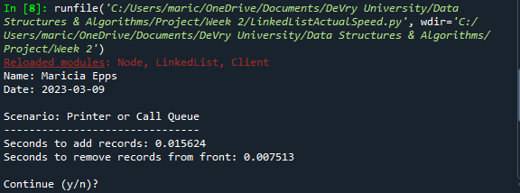
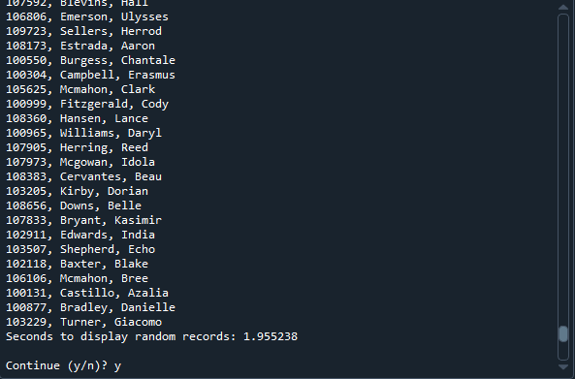
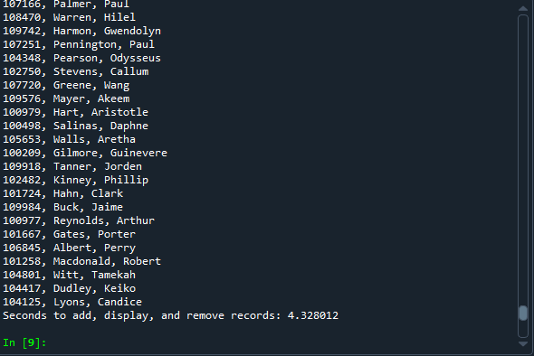
Screenshot of
Running Code
The output screenshot for the LinkedListActualSpeed.py

Slide 20
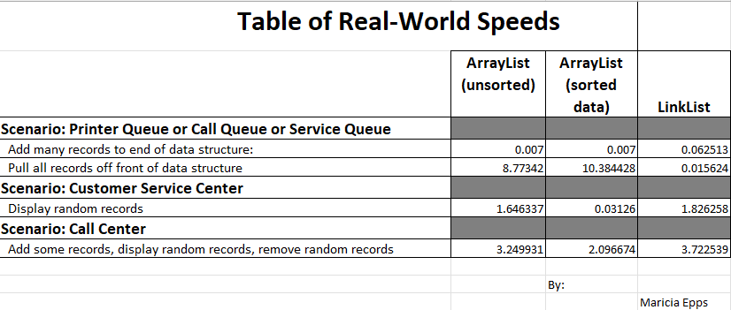
Table of Speeds
Times for the LinkedListActualSpeed.py code.
Printer Queue or Call Queue or Service Queue
  Add many records to end of data structure
  Pull all records off front of data structure
Customer Service Center
  Display random records
Call Center
  Add some records
  Display random records
  Remove some records

Slide 21
ADT Using Queue
Measure the call center call waiting queue using the following:
Automatic Call Distributor (ACD)
Queue Data Structure
Call objects created and used

Slide 22
Call.py
Python Code
Code:
#Name: Maricia Epps
#Date: March 17, 2023
from time import strftime # used for current date and time
class Call:
def __init__(self, client_id=0, client_name="Unknown", client_phone="Unknown"):
self.client_id = client_id
self.client_name = client_name
self.client_phone = client_phone
self.call_date = strftime("%m/%d/%Y")
self.call_time = strftime("%H:%M")
# __str__() method is automatically called when you print the object
def __str__(self):
return str(self.client_id) + "," + self.client_name + \
"\n\tPhone: " + self.client_phone + \
"\tDate/Time: " + self.call_date + " @ " + self.call_time
Include the following attributes and behaviors:
Attributes
  call_id
  customer_name
  customer_phone
  call_date
  call_time
Behaviors
  __str__

Slide 23
AutomaticCallDistributor.py
Python Code
Code:
#Name: Maricia Epps
#Date: March 17, 2023
from Queue import Queue
from Call import Call
from datetime import date
import time #use to pause the application
import random #use to generate random numbers
#display author's name and the date in the output
print("Name:", "Maricia Epps")
print("Date:", date.today())
print()
# create a list
calls = []
# read call records into the list
input_file_name = "CallsData.csv"
with open(input_file_name) as infile:
for line in infile:
#s split the line based on the commas
s = line.split(',')
client_id = int( s[0])
client_name = s [1]
client_phone = s [2]
# create a Call object based on the data from the line
a_call = Call(client_id, client_name, client_phone)
# add the Call object to the list
calls.append(a_call)
# Queue object for our calls
calls_waiting = Queue()
call_number = 0
Simulation of ADT
  Ask user how many times to repeat
  On each loop:
    Randomly generate a number from 1 to 3
    If 1, add call to queue
    If 2, remove call from queue
    If 3, do nothing

Slide 24
AutomaticCallDistributor.py
Python Code
Code:
# how long is the simulation?
seconds = int( input("How many seconds do you want to simulate? ") )
# run the simulation for the given number of seconds
for i in range (seconds):
print("-" * 40)
time.sleep(2) # pause application for given number of seconds
random_event = random.randint(1, 3)
# do event based on the random number generated
if random_event == 1:
print("Call received. Caller added to queue.")
calls_waiting.enqueue( calls[call_number] )
call_number += 1 # set up the next call
print("\tNumber of calls waiting in queue:", calls_waiting.get_length())
elif random_event == 2:
print("Call sent to representative for service.")
if calls_waiting.get_length() > 0:
print("Caller information:")
print(calls_waiting.dequeue())
else:
print("The call waiting queue is empty.")
print("\tNumber of calls waiting in queue:", calls_waiting.get_length())
else:
print("Nothng happened durting this second in time.")
print("\tNumber of calls waiting in queue:", calls_waiting.get_length())
print("\nThe 'Automatic Call Distributor' simulation has completed.")
Simulation of ADT
  Ask user how many times to repeat
  On each loop:
    Randomly generate a number from 1 to 3
    If 1, add call to queue
    If 2, remove call from queue
    If 3, do nothing

Slide 25
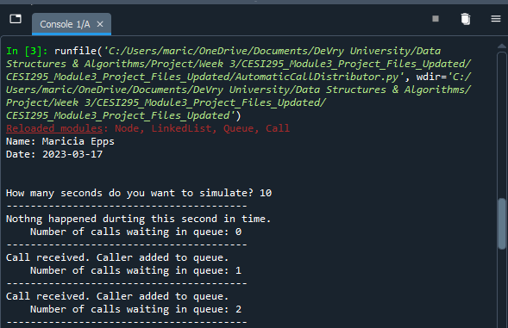
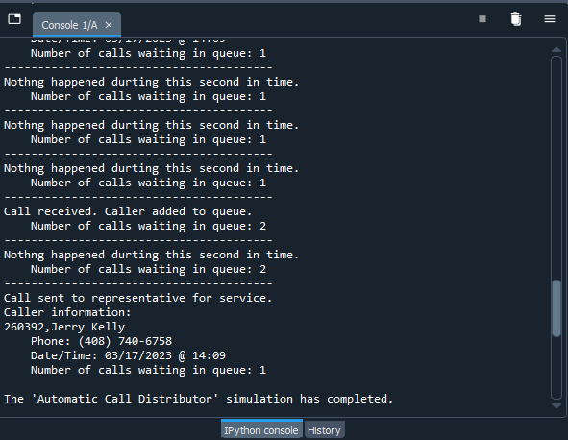
Screenshot of
Running Code
Screenshots of the AutomaticCallDistributor.py code running.

Slide 26
Sorting Speed
Measure the Sorting speed using the following sorting functions:
Bubble Sort
Selection Sort
Insertion Sort
Shell Sort
Quicksort
Merge Sort

Slide 27
Client.py
Python Code
Code:
# Name: Maricia Epps
# Date: March 25, 2023
class Client:
def __init__(self, client_id=0, first_name="Unknown", last_name="Unknown", phone="Unknown", email="Unknown"):
self. __client_id = client_id
self.__first_name = first_name
self.__last_name = last_name
self.__phone = phone
self.__email = email
# classes that compare objects must implement __eq__ and __lt__ methods
# __lt__ means "less than" and it must return a boolean
# __eq__ means "equals" and it must return a boolean
# __le__ means "less than or equal to" and it must return a boolean
def __lt__(self, other):
this_full_name = self.__last_name + " " + self.__first_name
other_full_name = other.__last_name + " " + other.__first_name
return this_full_name < other_full_name
def __le__(self, other):
this_full_name = self.__last_name + " " + self.__first_name
other_full_name = other.__last_name + " " + other.__first_name
return this_full_name <= other_full_name
def __eq__(self, other):
return self.__client_id == other.__client_id
# __str__() method is automatically called when you print the object
def __str__(self):
return self.__last_name + ", " + self.__first_name
Include the following attributes and behaviors:
Attributes
  __client_id
  __first_name
  __last_name
  __phone
  __email
Behaviors
  __lt__
  __le__
  __eq__
  __str__
Getters and Setters

Slide 28
Client.py
Python Code
Code:
# getters and setters
def get_client_id(self):
return self.__client_id
def set_client_id(self, client_id):
self.__client_id = client_id
def get_first_name(self):
return self.__first_name
def set_first_name(self, first_name):
self.__first_name = first_name
def get_last_name(self):
return self.__last_name
def set_last_name(self, last_name):
self.__last_name = last_name
def get_phone(self):
return self.__phone
def set_phone(self, phone):
self.__phone = phone
def get_email(self):
return self.__email
def set_email(self, email):
self.__email = email
Include the following attributes and behaviors:
Attributes
  __client_id
  __first_name
  __last_name
  __phone
  __email
Behaviors
  __lt__
  __le__
  __eq__
  __str__
Getters and Setters

Slide 29
SortingActualSpeed.py
Python Code
Code:
# Name: Maricia Epps
# Date: March 25, 2023
#from BubbleSort import BubbleSort
#from SelectionSort import SelectionSort
#from InsertionSort import InsertionSort
#from ShellSort import ShellSort
#from Quicksort import Quicksort
from MergeSort import MergeSort
from Client import Client
from datetime import date
import time # use to time the code executions
# display name and date in output
print("Name:", "Maricia Epps")
print("Date:", date.today())
print()
#input_file_name = 'ClientData100.csv'
#input_file_name = 'ClientData1000.csv'
#input_file_name = 'ClientData10000.csv'
input_file_name = 'ClientData100000.csv'
# create a list
clients = []
Read records into application
Test the following sorting algorithm speeds:
  Bubble Sort
  Selection Sort
  Insertion Sort
  Shell Sort
  Quicksort
  Merge Sort

Slide 30
SortingActualSpeed.py
Python Code
Code:
# read the records from the ClientData.csv file
# into Client objects and place the Client objects into the list
with open(input_file_name) as infile:
for line in infile:
# split the line based on the commas
s = line.split(',')
client_id = int( s[0] ) #convert the default string to an int
f_name = s[1]
l_name = s[2]
phone = s[3]
email = s[4]
# create a client object using the data from the file
clt = Client(client_id, f_name, l_name, phone, email)
# add the client object to the list
clients.append(clt)
# how many client objects do we have?
num_records = len(clients)
# Scenario: Sorting Records from a datafile
section_title = "Scenario: Sorting " + str(num_records) + " Records"
print(section_title)
print("-" * len(section_title))
# how long does it take to sort the records?
start_time = time.time()
Read records into application
Test the following sorting algorithm speeds:
  Bubble Sort
  Selection Sort
  Insertion Sort
  Shell Sort
  Quicksort
  Merge Sort

Slide 31
SortingActualSpeed.py
Python Code
Code:
# call the static sort method in the class
#BubbleSort.sort(clients)
#SelectionSort.sort(clients)
#InsertionSort.sort(clients)
#ShellSort.sort(clients)
#Quicksort.sort(clients)
MergeSort.sort(clients)
end_time = time.time()
total_time = end_time - start_time
print("Seconds to sort {0} records: {1:.6f}".format(num_records, total_time))
#display the sorted list
#for clt in clients:
# print(clt)
Read records into application
Test the following sorting algorithm speeds:
  Bubble Sort
  Selection Sort
  Insertion Sort
  Shell Sort
  Quicksort
  Merge Sort

Slide 32
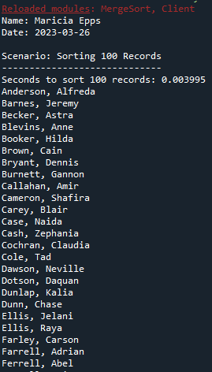
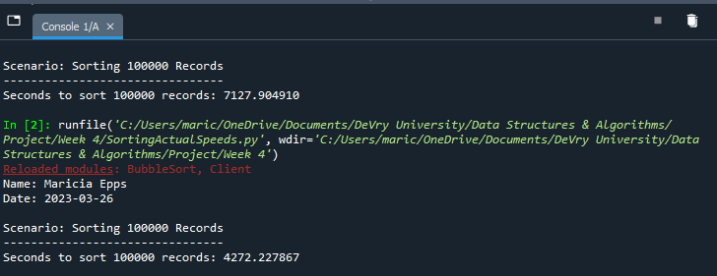
Screenshot of
Running Code
Screenshot of the SortingSpeed.py code running.

Slide 33
Table of Sorting Speeds
Table showing the time that it takes for the following sorting algorithms using different data sizes:
Bubble Sort
Selection Sort
Insertion Sort
Shell Sort
Quicksort
Merge Sort

Slide 34
Real-World Searching Speeds
Measure searching speeds using the following:
Bubble Sort
Selection Sort
Insertion Sort
Shell Sort
Quick Sort
Merge Sort

Slide 35
Client.py
Python Code
Code:
# Name: Maricia Epps
# Date: March 25, 2023
class Client:
def __init__(self, client_id=0, first_name="Unknown", last_name="Unknown", phone="Unknown", email="Unknown"):
self. __client_id = client_id
self.__first_name = first_name
self.__last_name = last_name
self.__phone = phone
self.__email = email
# classes that compare objects must implement __eq__ and __lt__ methods
# __lt__ means "less than" and it must return a boolean
# __eq__ means "equals" and it must return a boolean
# __le__ means "less than or equal to" and it must return a boolean
def __lt__(self, other):
return self.__client_id < other.__client_id
def __le__(self, other):
return self.__client_id <= other.__client_id
def __eq__(self, other):
return self.__client_id == other.__client_id
# __str__() method is automatically called when you print the object
def __str__(self):
return str(self.__client_id) + ", " + self.__last_name + ", " + self.__first_name
Include the following attributes and behaviors:
Attributes
  __client_id
  __first_name
  __last_name
  __phone
  __email
Behaviors
  __lt__
  __eq__
  __str__
Getters and Setters

Slide 36
Client.py
Python Code
Code:
# getters and setters
def get_client_id(self):
return self.__client_id
def set_client_id(self, client_id):
self.__client_id = client_id
def get_first_name(self):
return self.__first_name
def set_first_name(self, first_name):
self.__first_name = first_name
def get_last_name(self):
return self.__last_name
def set_last_name(self, last_name):
self.__last_name = last_name
def get_phone(self):
return self.__phone
def set_phone(self, phone):
self.__phone = phone
def get_email(self):
return self.__email
def set_email(self, email):
self.__email = email
Include the following attributes and behaviors:
Attributes
  __client_id
  __first_name
  __last_name
  __phone
  __email
Behaviors
  __lt__
  __eq__
  __str__
Getters and Setters

Slide 37
SearchingActualSpeed.py
Python Code
Code:
# Name: Maricia Epps
# Date: March 31, 2023
from LinearSearch import LinearSearch
#from BinarySearch import BinarySearch
from Quicksort import Quicksort
from Client import Client
from datetime import date
import random # use to generate random numbers
import time # use to time the code executions
import sys # use to exit the application early
# display name and date in output
print("Name:", "Maricia Epps")
print("Date:", date.today())
print()
#input_file_name = 'ClientData100.csv'
input_file_name = 'ClientData1000.csv'
#input_file_name = 'ClientData10000.csv'
#input_file_name = 'ClientData100000.csv'
# create a list
clients = []
# read the records from the ClientData.csv file
# into Client objects and place the Client objects into the list
with open(input_file_name) as infile:
for line in infile:
# split the line based on the commas
s = line.split(',')
client_id = int( s[0] ) #convert the default string to an int
f_name = s[1]
l_name = s[2]
phone = s[3]
email = s[4]
Read records into application
Test the following searching algorithm speeds:
  Linear Search
  Binary Search
Test these two algorithms against different size datasets
  100 records
  1,000 records
  10,000 records
  100,000 records

Slide 38
SearchingActualSpeed.py
Python Code
Code:
# create a client object using the data from the file
clt = Client(client_id, f_name, l_name, phone, email)
# add the client object to the list
clients.append(clt)
# how many client objects do we have?
num_records = len(clients)
# Scenario: Search for 1000 records from a datafile
section_title = "Scenario: Searching Through " + str(num_records) + " Records"
print(section_title)
print("-" * len(section_title))
# MUST SORT THE DATA TO DO A BINARY SEARCH
Quicksort.sort(clients)
#start and end record numbers
start_record = 100001
end_record = start_record + num_records
# how long does it take to sort the records?
start_time = time.time()
# how long does it take to do a random linear search through the records?
for i in range(1000):
client_id = random.randint(start_record, end_record)
clt = Client(client_id)
result = LinearSearch.search(clients, clt)
#result = BinarySearch.search(clients, clt)
if result is None:
print(clt, "was not found.")
else:
print(result)
Read records into application
Test the following searching algorithm speeds:
  Linear Search
  Binary Search
Test these two algorithms against different size datasets
  100 records
  1,000 records
  10,000 records
  100,000 records

Slide 39
SearchingActualSpeed.py
Python Code
Code:
end_time = time.time()
total_time = end_time - start_time
print("Seconds to linear search for 1000 random records: {:.6f}".format(total_time))
#print("Seconds to binary search for 1000 random records: {:.6f}".format(total_time))
Read records into application
Test the following searching algorithm speeds:
  Linear Search
  Binary Search
Test these two algorithms against different size datasets
  100 records
  1,000 records
  10,000 records
  100,000 records

Slide 40
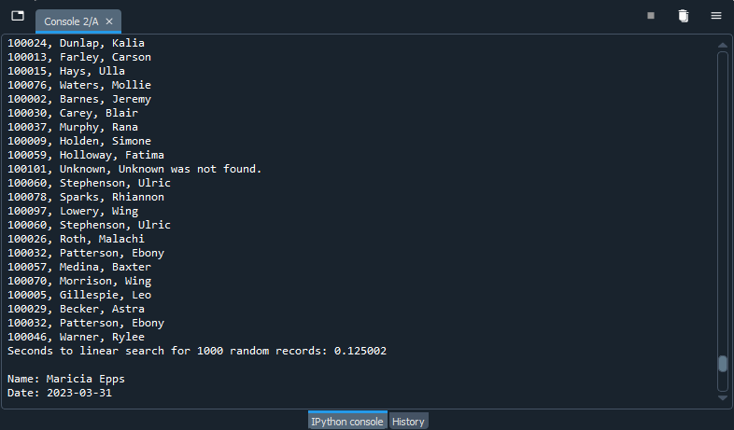
Screenshot of
Running Code
Screenshot of SearchingSpeed.py code running.

Slide 41
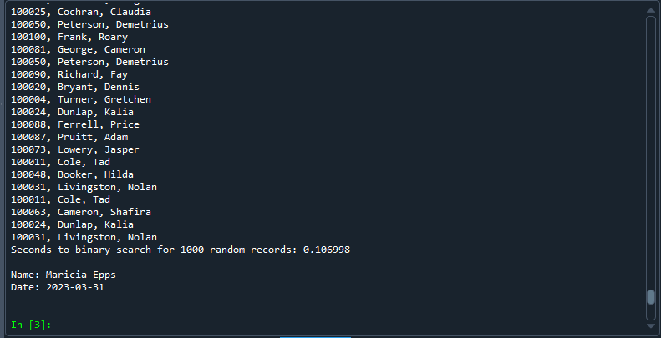
Screenshot of
Running Code
Screenshot of SearchingSpeed.py code running.

Slide 42
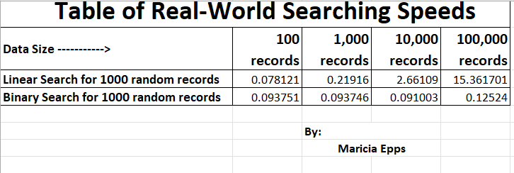
Table of Searching Speeds
Table showing the time that it takes for the following searching algorithms using different data sizes:
Linear Search
Binary Search

Slide 43
Binary Search Tree
Measure speed of the Binary Search Tree using the following scenarios:
Printer Queue or Service Queue
Service Center
Call Center

Slide 44
BinarySearchTreeActualSpeed.py
Python Code
Code:
# Name: Maricia Epps
# Date: April 7, 2023
from BinarySearchTree import BinarySearchTree
from Client import Client
from datetime import date
import random # use to generate random numbers
import time # use to time the code executions
import sys # use to exit the application early
# display name and date in output
print("Name:", "Maricia Epps")
print("Date:", date.today())
print()
# create a list
clients = []
# read the records from the ClientData.csv file
input_file_name = 'ClientData.csv'
with open(input_file_name) as infile:
for line in infile:
# split the line based on the commas
s = line.split(',')
client_id = int( s[0] ) #convert the default string to an int
f_name = s[1]
l_name = s[2]
phone = s[3]
email = s[4]
# create a client object using the data from the file
clt = Client(client_id, f_name, l_name, phone, email)
# add the client object to the list
clients.append(clt)
Read records into application
Test the following process speeds:
  Add records to beginning of data structure
  Add records to end of data structure
  Add records to middle of data structure
  Retrieve records from beginning of data structure
  Retrieve records from end of data structure
  Retrieve records from middle of data structure

Slide 45
BinarySearchTreeActualSpeed.py
Python Code
Code:
# how many client objects do we have?
num_records = len( clients)
# create the Binary Search Tree to test real-world speeds
my_bst = BinarySearchTree()
# Scenario 1: Printer Queue or Call Queue or Service Queue
section_title = "Scenario: Printer Queue or Call Queue or Service Queue"
print(section_title)
print( "-" * len(section_title))
# how long does it take to add the client records to the BST?
start_time = time.time()
for i in range(num_records):
my_bst.insert(clients[i])
end_time = time.time()
total_time = end_time - start_time
print("Seconds to add records: {:.6f}".format(total_time)) # .6f means six decimal places
# how long does it take to remove records from the front (smallest) of the BST?
start_time = time.time()
for i in range(num_records):
my_bst.insert(clients[i])
end_time = time.time()
total_time = end_time - start_time
print("Seconds to remove records: {:.6f}".format(total_time)) # .6f means six decimal places
Read records into application
Test the following process speeds:
  Add records to beginning of data structure
  Add records to end of data structure
  Add records to middle of data structure
  Retrieve records from beginning of data structure
  Retrieve records from end of data structure
  Retrieve records from middle of data structure

Slide 46
BinarySearchTreeActualSpeed.py
Python Code
Code:
# Scenario 2: Customer Service Center
answer = input("Continue (y/n)? ")
if answer.lower() != "y":
sys.exit() # end the application
section_title = "Scenario: Customer Service Center"
print(section_title)
print( "-" * len(section_title))
# add clients to the BinarySearchTree
for i in range(num_records):
my_bst.insert(clients[i])
# how long does it take to randomly display 1000 client records to the BST?
start_time = time.time()
for i in range(1000):
smallest_id = 100001
largest_id = smallest_id + num_records
random_num = random.randint(smallest_id, largest_id)
print( my_bst.search(Client(random_num)))
end_time = time.time()
total_time = end_time - start_time
print("Seconds to display 1000 random records: {:.6f}".format(total_time)) # .6f means six decimal places
# Scenario 3: Call Center
answer = input("Continue (y/n)? ")
if answer.lower() != "y":
sys.exit() # end the application
section_title = "Scenario: Call Center"
print(section_title)
print( "-" * len(section_title))
Read records into application
Test the following process speeds:
  Add records to beginning of data structure
  Add records to end of data structure
  Add records to middle of data structure
  Retrieve records from beginning of data structure
  Retrieve records from end of data structure
  Retrieve records from middle of data structure

Slide 47
BinarySearchTreeActualSpeed.py
Python Code
Code:
# add clients to the BinarySearchTree
for i in range(num_records):
my_bst.insert(clients[i])
# how long does it take to search for 1000 client records,
# randomly display 1000 records and randomly remove 1000 records from the BST?
start_time = time.time()
# add records
current_id = 100001 + num_records + 1
for i in range(1000):
my_bst.insert(Client(current_id))
current_id += 1
# display records
for i in range(num_records):
smallest_id = 100001
largest_id = smallest_id + num_records
random_num = random.randint(smallest_id, largest_id)
print( my_bst.search(Client(random_num)))
# remove 1000 random records
for i in range(num_records):
smallest_id = 100001
largest_id = smallest_id + num_records
random_num = random.randint(smallest_id, largest_id)
my_bst.remove(Client(random_num))
end_time = time.time()
total_time = end_time - start_time
print("Seconds to add records,")
print("display 1000 random records,")
print("and remove 1000 random records): {:.6f}".format(total_time)) # .6f means six decimal places
Read records into application
Test the following process speeds:
  Add records to beginning of data structure
  Add records to end of data structure
  Add records to middle of data structure
  Retrieve records from beginning of data structure
  Retrieve records from end of data structure
  Retrieve records from middle of data structure

Slide 48
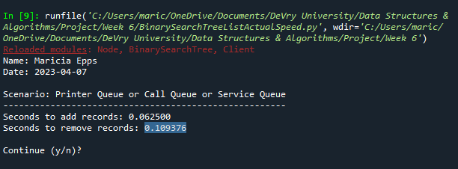
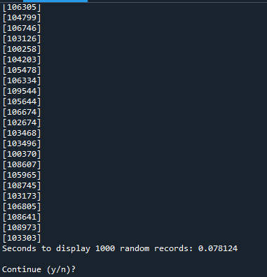
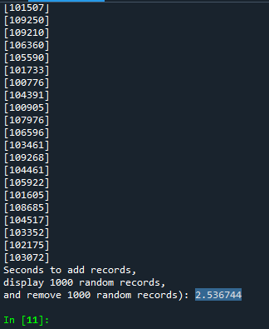
Screenshot of Running Code
Screenshot of the BinarySearchTreeActualSpeed.py code running.

Slide 49
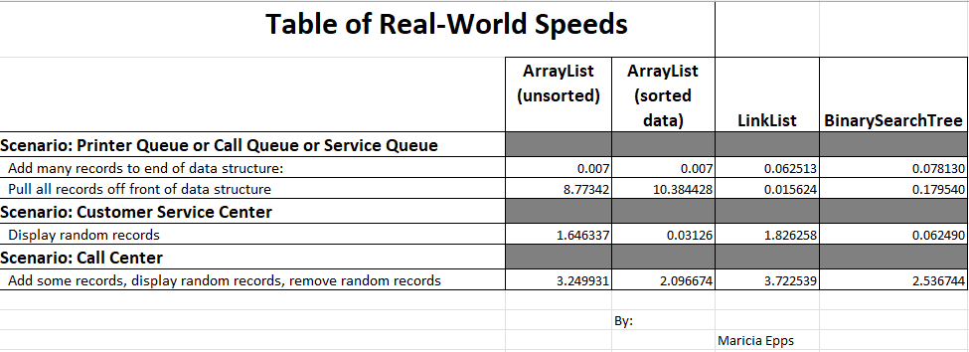
Table of Speeds
Table of the BinarySearchTree results
Printer Queue or Call Queue or Service Queue
  Add many records to end of data structure
  Pull all records off front of data structure
Customer Service Center
  Display random records
Call Center
  Add some records
  Display random records
  Remove some records

Slide 50
Challenges
The challenges I faced completing this project were:
Results not printing in the correct format
Results not printing at all
Typos in my Python code
Determining which functions to use to measure algorithm speeds

Slide 51
Career Skills
Problem-solving
Analysis
Python Programming
Troubleshooting
Debugging
Excel
PowerPoint

Slide 52
Conclusion
This project provided experience with Python programming, object-oriented programming, algorithm speeds and analysis, and the fundamentals of data structures. Through this project I found out that the ArrayList is best used in a service center to access data. The LinkedList is best used in a Printer Queue or Service Queue as it is fast for adding and removing data from the front and back of the queue. The Binary Search Tree is best used in a call center as it fast for adding and removing data as well as accessing data as long as the tree is balanced.

